Slide 1
FAIRsFAIR and implementing the FAIR principles - a Finnish perspective
Jessica Parland-von Essen & Josefine Nordling 15.4.2020
https://www.fairdata.fi/koulutus/koulutuksen-tallenteet/

Slide 2
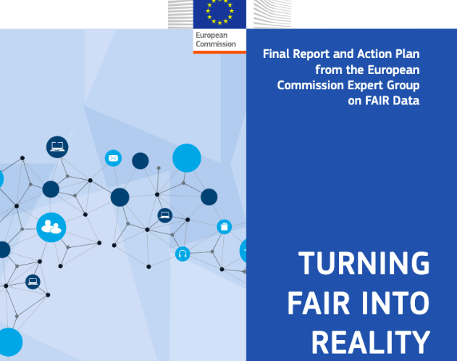
Turning FAIR into Reality
Final Report and Action Plan from the European Commission Expert Group on FAIR Data (2018)
Step 1: Define – concepts for FAIR Digital Objects and the ecosystem
Rec. 1: Define FAIR for implementation
Rec. 2: Implement a model for FAIR Digital Objects
Rec. 3: Develop components of a FAIR ecosystem
Step 2: Implement – culture, technology and skills for FAIR practice
Rec. 4: Develop interoperability frameworks for FAIR sharing within disciplines and for interdisciplinary research
Rec. 7: Support semantic technologies …
https://doi.org/doi:10.2777/1524

Slide 3
Creating a FAIR Ecosystem

Slide 4
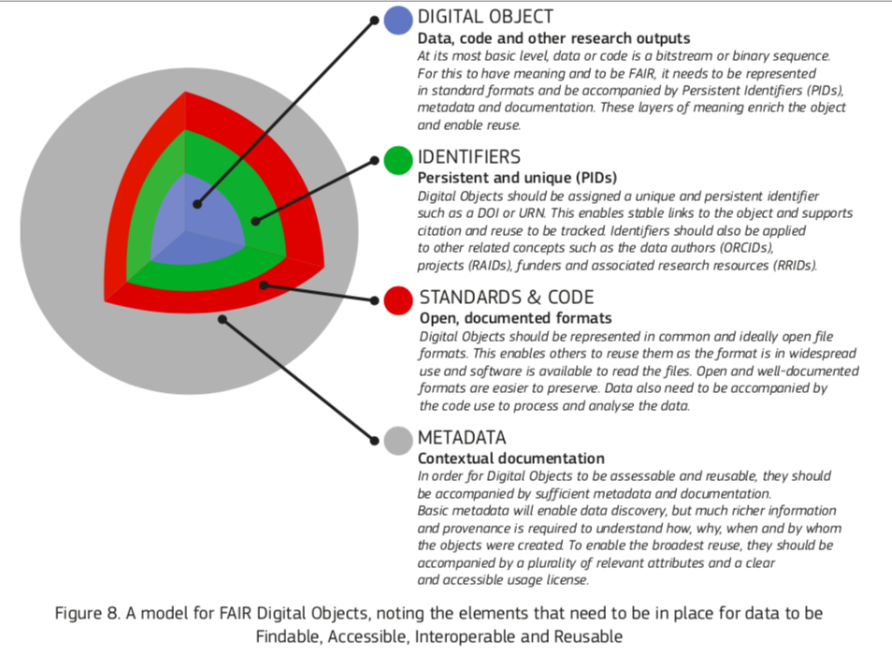
FAIR Ecosystem Components
TFiR https://doi.org/doi:10.2777/1524
http://doi.org/10.5281/zenodo.3565428

Slide 5
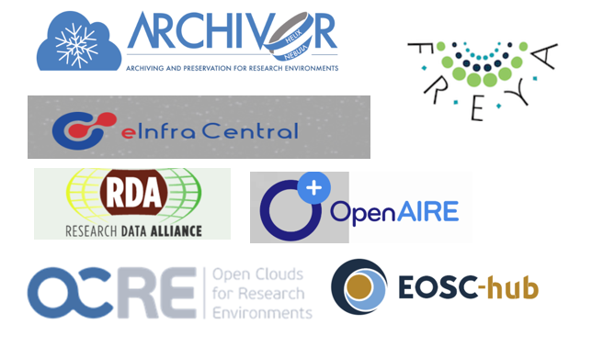
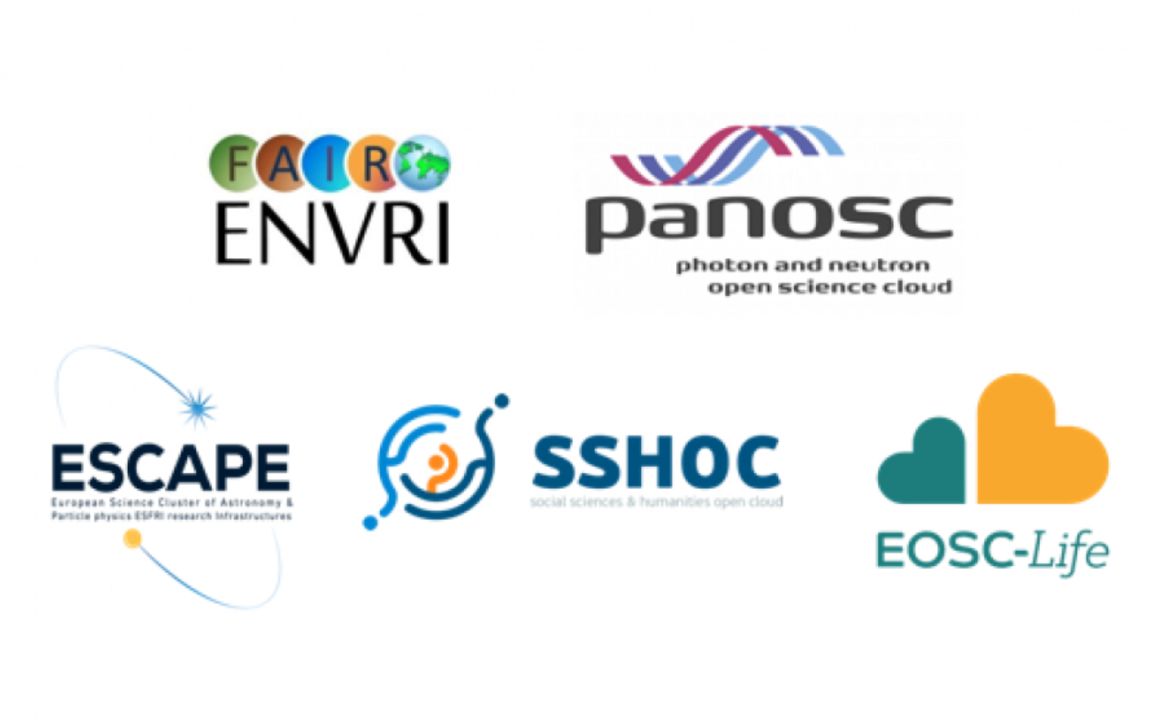
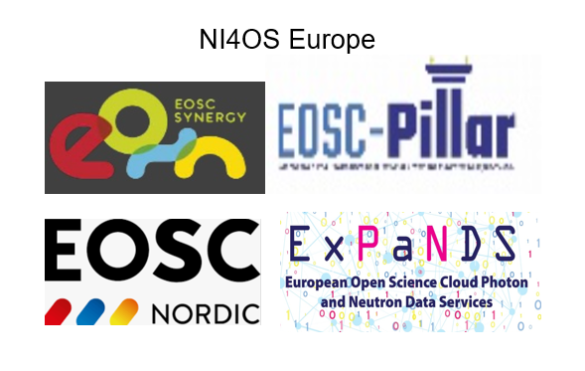
EOSC
Governance Board
‘Horizontals’
(5a)
EOSC
Executive Board
ESFRI Clusters
Regional Nodes / Thematic Projects (5b)
Other FAIR initiatives
FAIR (5c)
INFRAEOSC-5 Cross Project Collaboration Board
INFRAEOSC-5 Task Forces

Slide 6
Facilitating FAIR in EOSC
Practice and policy
Training and education
Certification
https://fairsfair.eu/

Slide 7
D3.3 FAIR Policy Enhancement Recommendations
Based on D3.1 FAIR Policy Landscape Analysis https://doi.org/10.5281/zenodo.3558173, some examples:
Building on the work of other initiatives (FAIRsharing, EOSCpilot, RDA), agree on a common set of FAIR policy elements and work with stakeholders to employ them to describe their policies. The emphasis should be on describing those policy elements that may be considered ‘rules’ rather than simply suggested good practice to support machine-actionability.
Standardised exceptions for not sharing data should be developed and promoted in associated policy guidance.
Provide mechanisms to enable searching for data by license type in repositories.
Support researchers to assess the potential risks, benefits and associated costs to enable the sharing of FAIR data as they draft their DMP.
RDM support should place an emphasis on selecting which data to make and keep FAIR as well as advising on where data should be deposited
https://doi.org/10.5281/zenodo.3686901

Slide 8
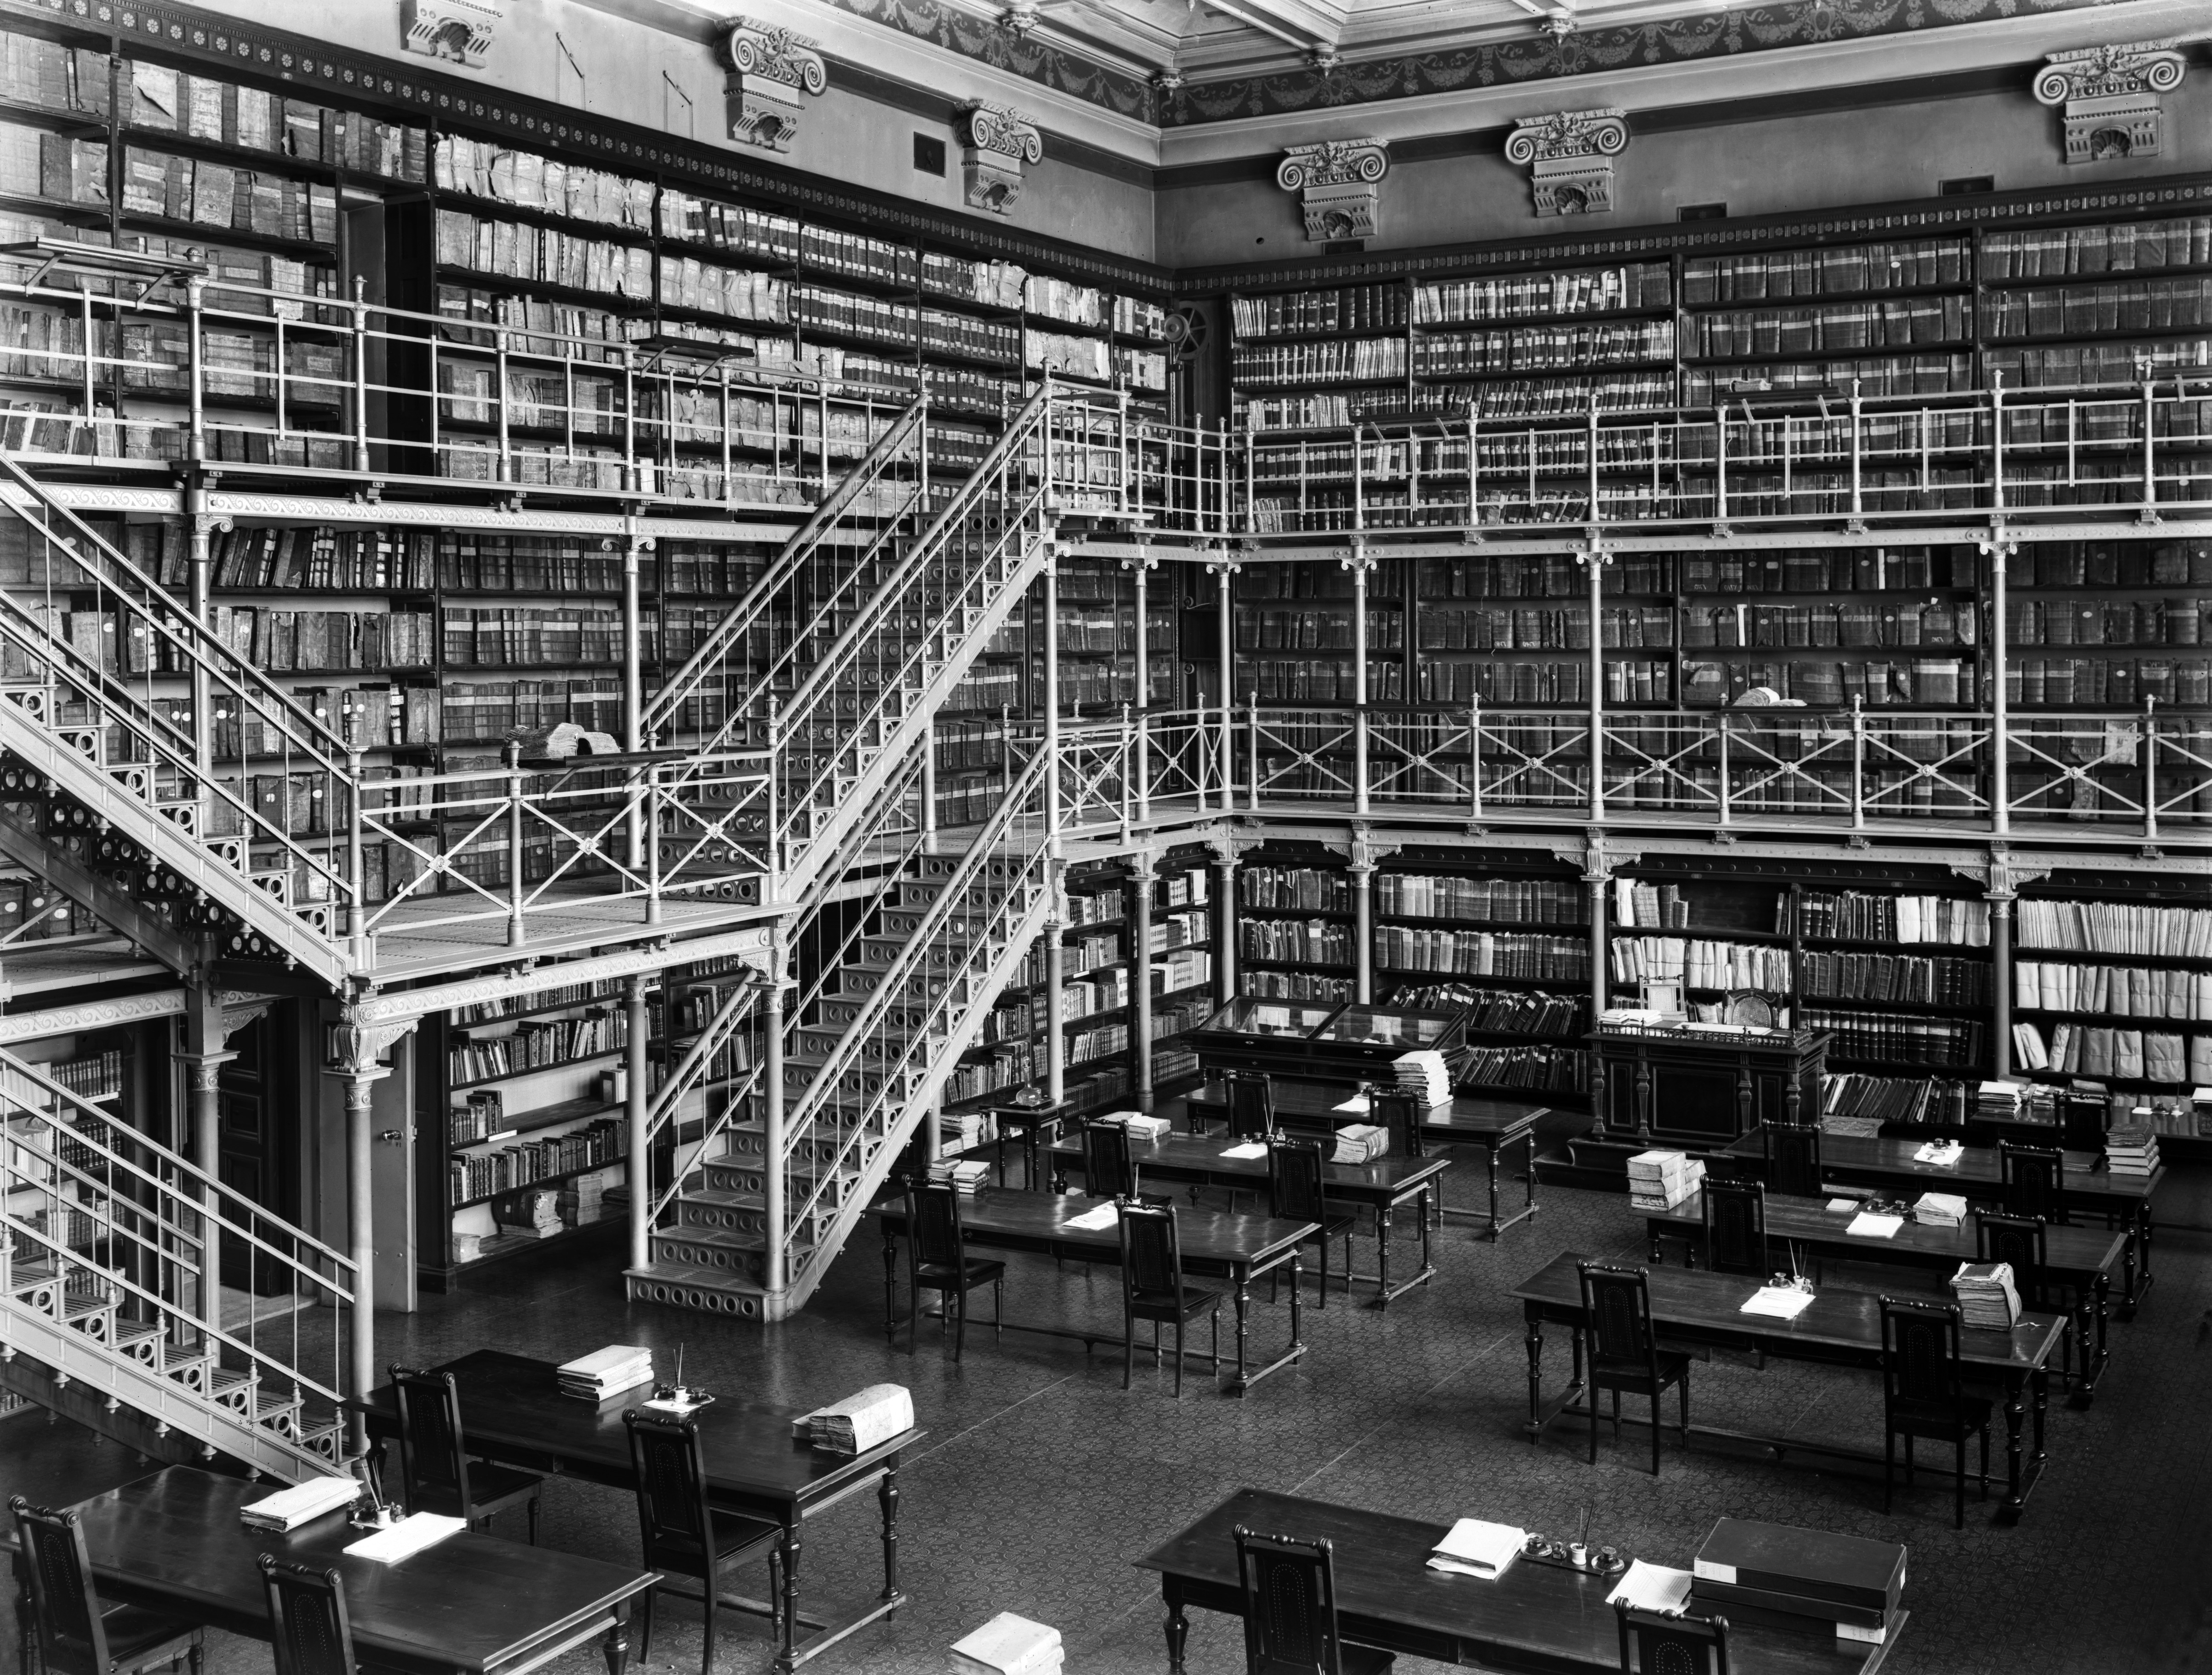
D3.2 FAIR Data Practice Analysis
Landscape review
ESFRI clusters
Examples of good practices
Good community metadata
Data management planning templates
Mandatory DMP training
Published DMPs in catalogue
Tools for assessing data quality and FAIRness
National Archives of Finland. Photo: Helsinki City Museum https://finna.fi/Record/hkm.HKMS000005:00000zfk
https://doi.org/10.5281/zenodo.3581353

Slide 9
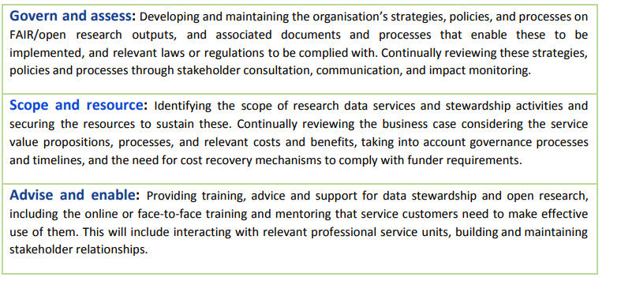
https://doi.org/10.5281/zenodo.3581353

Slide 10
Towards enabling FAIR data

Slide 11
FAIR compliance in services?
M2.7 Assessment Report on 'FAIRness of Services'
https://doi.org/10.5281/zenodo.3688762
There are many frameworks to assess FAIRness of datasets
RDA maturity model
FAIR assist
See further examples in report
Core Trust Seal, Rules of participation and FitSM examples of tools for assessing services, but they don’t address alignment with the FAIR principles per se
Sufficient metadata, PID management and API are elements in providing FAIR support
A service can enable, respect or reduce the FAIRness of a digital object

Slide 12
D4.1 Recommendations on Requirements for FAIR Datasets in Certified Repositories
Trusted Digital Repositories are an important element of the FAIR Ecosystem, as they offer long-term stewardship to keep the data objects FAIR
The CoreTrustSeal offers a certification process for assessing repositories
Most of the FAIR data principles are either explicitly or implicitly covered by the CoreTrustSeal requirements
Assessment during different stages of the RDM lifecycle. Examples
For the researcher manual evaluation https://satifyd.dans.knaw.nl/
For the repository FsF metrics to support CTS evaluation
https://doi.org/10.5281/zenodo.3678716

Slide 13
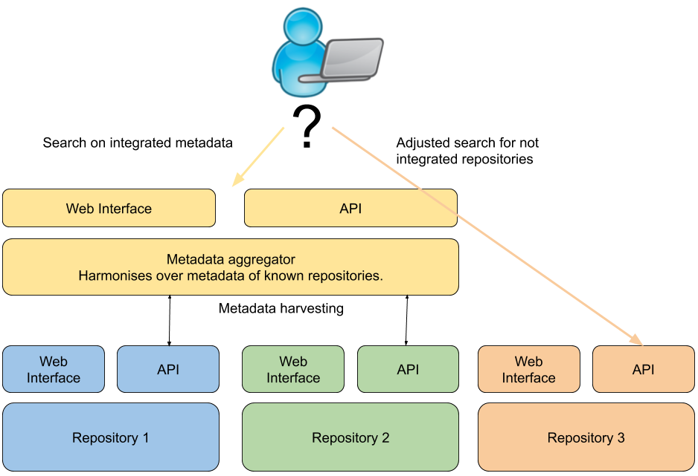
How a repository can support the FAIR data principles
The goal is an API that exposes FAIR data
– read more about the project
https://fairsfair.eu/application-results-open-call-data-repositories

Slide 14
D2.3 Set of FAIR data repositories features
Metadata for digital objects:
The repository should provide metadata in different formats, which can be harvested by different search engines (I)
Metadata should be provided as RDF, including JSON-LD. Based on these machines can provide human-friendly presentations/visualisations by resolving the URIs and retrieving the human-readable labels (I)
Providing metadata at the level of files, variables, attributes, individual cells, granularity to be decided by the repository (I)
Gather provenance metadata on digital objects and files upon upload (IR)
Provide masks and ways to quickly upload metadata (I)
Demand fine-grained metadata from data providers (FI)
Implement community standards (FI)
Automatic ontology suggestions and lookup (IF)
Landing pages should be machine-interpretable or implement content negotiation, have metadata in different formats (FI)
HTTP header should contain technical metadata about the DO (FI)
Machine-readable and interpretable metadata about repository itself (I)
Expose (Meta) Data Model (in machine-readable form) (I)
PID policies
PID for each digital object or file (I)
Use global persistent identifiers (I)
The target of PID should be inferable by machines from PID metadata itself, employ PID information types or Linked Data type (I)
Data object and file requirements
Connect compute infrastructures and data repositories (to avoid commuting data) (I)
Subsetting of data (I)
Technical support for predefined file formats (including complex data formats like netCDF), with a preference for open file formats (FI)
Machine-readable license (R)
The repository should provide a search interface or be linked to aggregating services that enable findability (F)
https://doi.org/10.5281/zenodo.3631528

Slide 15
What FAIRsFAIR metrics could be like
FsF-F1-01D Universally Unique Identifier
FsF-F1-02D Persistent Identifier
FsF-F2-01M Descriptive Metadata
FsF-F3-01M Inclusion of Data Identifier in Metadata
FsF-F4-01M Searchable Metadata
FsF-A1-01M Data Access Level
FsF-A2-01M Metadata Preservation
FsF-I1-01M Semantic Representation of Metadata
FsF-I3-01M Qualified References to Related Entities
FsF-R1-01M Community-Driven Metadata
FsF-R1-02M Data Content Description
FsF-R1.1-01M Data Usage Licence
FsF-R1.3-01D Standard File Format
https://doi.org/10.5281/zenodo.3678716

Slide 16
Pillars of FAIRness

Slide 17
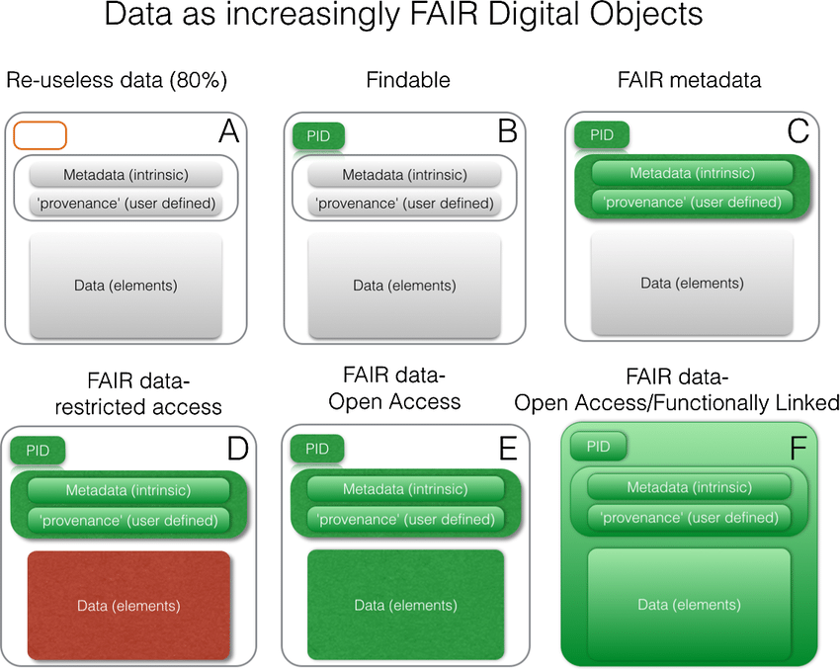
FINDABLE
ACCESSIBLE
INTEROPERABLE
Mons, Barend & Neylon, Cameron
& Velterop, Jan & Dumontier, Michel
& Bonino da Silva Santos, Luiz Olavo & Wilkinson, Mark.
(2017). Cloudy, increasingly FAIR; Revisiting the FAIR Data guiding principles for the European Open Science Cloud.
Information Services & Use. 37. 1-8.
https://doi.org/doi:10.3233/ISU-170824
RE-USABLE

Slide 18
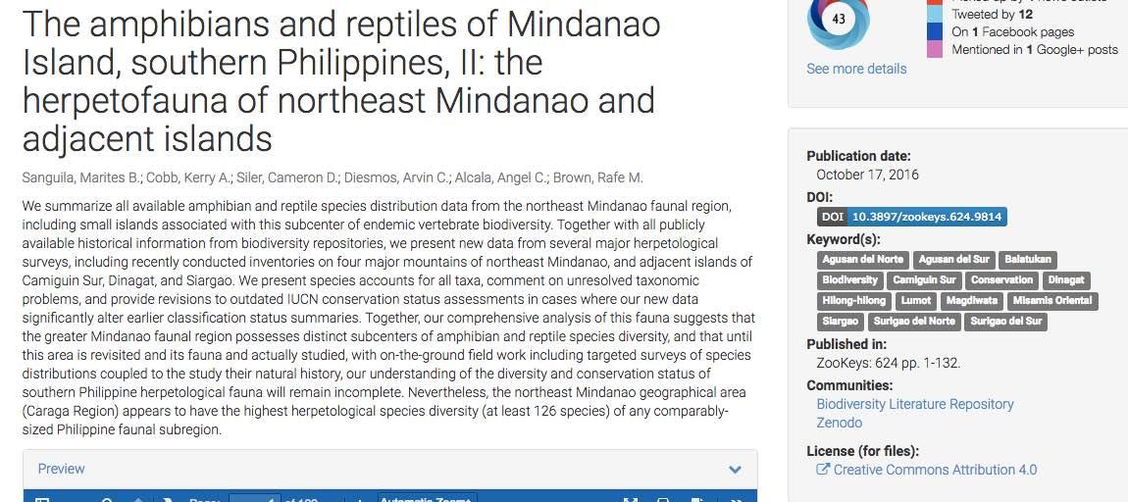
Persistent identifiers are
necessary for research and a key element in FAIR data
Resolver
Data file
Read me
PID
License
Data catalog
Configuration
file
Notes:
So what is a persistent identifier? The point is, that many web links break over time. In fact most do.* When research sources are digital, we would like the links to them to be presistent. To make identifiers last over changes in organisations, web domain names or technical solutions we use resolvers. These keep track of where the data is currently stored and redirects you to a landing page with metadata about the dataset. This way we can ensure reproducibility, Usually the persistent identifier has a recognizable format: it is a DOI or a URN and uses this as a “neutral” domain name in the URL (verkko-osoite)
The DOI for research data is called a DataCIte DOI and is registered with metadata in the DataCite service. (Metadata will be explained a bit later)
From the national recommendation:
https://vm.fi/documents/10623/5430575/Tunnuskaytanteet_julkisessahallinnossa_selvitys2017_v1.01.pdf/b9b3631f-4040-4ca3-bf2f-173636e1e015/Tunnuskaytanteet_julkisessahallinnossa_selvitys2017_v1.01.pdf.pdf
Resolvoitavissa olevaa tunnistetta kutsutaan toiminnalliseksi.
Resoluutiolla tarkoitetaan identifioituun kohteeseen liittyvien palvelujen tarjoamista. Palvelu voi olla esimerkiksi Internet-resurssin tai kuvaavien metatietojen URL-osoitteen hakeminen tai metatietojen lähettäminen (jos ne on tallennettu resoluutiopalveluun, kuten ARK-tunnistejärjestelmässä).
Resoluutiopalvelun antama URL-osoite ei välttämättä ole lopullisen kohdesivun URL-osoite, vaan osoitteessa käytetty protokolla kuten HTTP voi uudelleenohjauksella siirtää käyttäjän resurssin oikeaan URL-osoitteeseen.1
Resoluutiopalvelu (resolveri) on toiminnallisten tunnisteiden resolvoinnista vastaava sovellus, kuten Handle system, jota käytetään sekä Handle- että DOI-järjestelmissä (Digital Object Identifier). URN- tunnuksella (Uniform Resource Name) ei ole yhtä yhteistä sovelluspakettia, vaan periaatteessa jokaisella URN-tunnuksia jakavalla taholla on oma resolverisovellus. Resoluutiopalvelu voi sisältää monenlaista älykkyyttä ja lisäpalveluita, joten on syytä valita tarpeita parhaiten palveleva luotettava palvelu.
*Research on link rot: Martin Klein et al., Scholarly Context Not Found: One in Five Articles Suffers from Reference Rot. Published: December 26, 2014https://doi.org/10.1371/journal.pone.0115253. Julie McMurry, Lilly WInfree, Melissa Haendel: Bad identifiers are the Potholes of the Information Superhighway. Herbert Van de Sompel & Michael L. Nelson, Reminiscing About 15 Years of Interoperability Efforts. D-Lib Magazine. November/December 2015 DOI: 10.1045/november2015-vandesompel

Slide 19
Persistent identifiers and research data in Finland
URN, DOI and handle are common PIDs for research data
The DataCite Finland Consortium offers access to minting DOI
CSC is also a member in the ePIC Consortium (handle identifiers)
CSC PID Policy
https://research.csc.fi/pid-policy
PID info
https://wiki.eduuni.fi/display/CscPidVerkosto/PID-verkosto
Open Science WG
https://wiki.eduuni.fi/x/GYv6B
PID Forum
https://www.pidforum.org/
EOSC PID Policy
https://doi.org/10.5281/zenodo.3574203

Slide 20
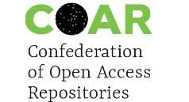
D2.1 Report on FAIR requirements for persistence and interoperability 2019
FAIR technologies and methods
Semantic interoperability
Semantic artefacts
PIDs and PID services
FAIR in the context of the data life cycle
Repositories
Evolving datasets and data citation
ESFRI RI’s
Metadata, persistent identifiers, semantic artefacts in different domain infrastrucutres
http://doi.org/10.5281/zenodo.3557381

Slide 21
Semantic Interoperability
Interoperability is the ability of computer systems to transmit data with unambiguous, shared meaning. Semantic interoperability is a requirement to enable machine computable logic, inferencing, knowledge discovery, and data federation between information systems. Semantic interoperability is achieved when the information transferred has, in its communicated form, all of the meaning required for the receiving system to interpret it correctly, even when the algorithms used by the receiving system are unknown to the sending system. Syntactic interoperability is a prerequisite to semantic interoperability.
CASRAI. https://dictionary.casrai.org/Semantic_interoperability
Read more about the European Interoperability Framework (EIF) https://ec.europa.eu/isa2/eif_en
Trans-language interoperability
http://doi.org/10.5281/zenodo.3557381

Slide 22
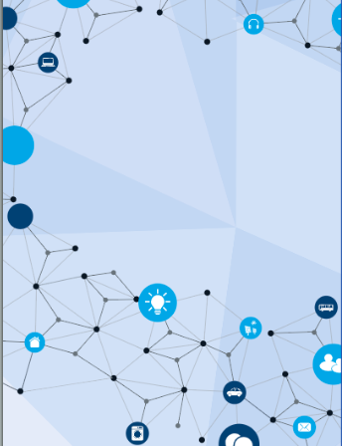
Semantic artefacts adoption
 | Characteristics | Indicators
Coverage in field | widely approved and adopted | used within community, acknowledged mandate
Coverage of content | sufficient amount of the terminology | coverage, completeness, coherence
 | structure corresponds to the ontology of the domain | certification, quality, community approval
Governance | usable and fit the purpose | compatibility, format, granularity, workflow
 | actively maintained by a trusted, authoritative party | curation, versioning, persistence
 | (re)usability | open access and licence and documented
http://doi.org/10.5281/zenodo.3557381

Slide 23
D2.2 FAIR Semantics: First recommendations
To create semantic interoperability we need semantic artefacts that make semantics machine readable
Semantic artefacts can be considered a special type of dataset that the FAIR data principles can be customized for
To support a FAIR Ecosystem well the semantic artefacts should meet more specific requirements
The 17 preliminary technical recommendations presented in D2.2 are under discussion among experts in RDA VSSIG and FAIRsFAIR organized activites
Semantic artefacts are most easily made FAIR by creating them FAIR from the start
https://doi.org/10.5281/zenodo.3707985

Slide 24
Recommendations for best practice regarding FAIR semantics
BP-Rec. 1: Use a unique naming convention for concept/class and relations
BP-Rec. 2: Use an Ontology Naming Convention
BP-Rec. 3: Use defined ontology design patterns
BP-Rec. 4: Create mappings validated by domain experts
BP-Rec. 5: Define workflows between different formats
BP-Rec. 6: Harmonize the methodologies used to develop semantic artefacts
BP-Rec. 7: Interact with the designated community and manage user-centric development
BP-Rec. 8: Provide a structured definition for each concept
BP-Rec. 9: The underlying logic of semantic artefacts should be grounded on the domain it intends to describe
BP-Rec. 10: Define a set of governance policies for the semantic artefacts
TO BE DISCUSSED
https://doi.org/10.5281/zenodo.3707985

Slide 25
Semantic vocabulary services in Finland
The Finto service offers a good service for SKOS ontologies, suitable for offering terminologies in a well structured way
http://finto.fi/yso/fi/
The Helsinki Term Bank for the Arts and the Sciences also offers platform, though not FAIR
https://tieteentermipankki.fi/wiki/Termipankki:Etusivu/en
Species published as linked data
https://laji.fi/
See also Heldig
https://www.helsinki.fi/en/helsinki-centre-for-digital-humanities/infrastructure
Yhteentoimivia.suomi.fi

Slide 26
FAIR: The Landscape of Persistence and Interoperability 2019
FAIRness on a more generic level is not ready and clearly defined yet, but key elements are clear.
The most popular, potentially most useful, and most complex approaches on improving FAIRness of data are based on technologies using Linked Data.
http://doi.org/10.5281/zenodo.3557381

Slide 27
FAIR: The Landscape of Persistence and Interoperability 2019
Semantic artefacts are important in building interoperability and good quality (meta)data.
Crosswalks, mappings and semantic application profiles should be published and registered in machine readable formats.
Reuse of semantic artefacts should be promoted by publishing application profiles. Curated registries like the EOSC Hub, FAIRsharing and re3data.org are important resources.
http://doi.org/10.5281/zenodo.3557381

Slide 28
FAIR: The Landscape of Persistence and Interoperability 2019
The development should be research rather than technology driven.
The landscape is diverse in all aspects. Differences inside domains are often bigger than differences between domains.
Data citation and machine actionable solutions should be developed in parallel. Community adoption and trust are the decisive factors.
http://doi.org/10.5281/zenodo.3557381

Slide 29
FAIR: The Landscape of Persistence and Interoperability 2019
Solutions should be user friendly, context sensitive and transparent to the users.
PID and data type registries should promote reuse rather than bulk creation of PIDs. To support interoperability, they should be considered semantic artefacts and used mindfully.
http://doi.org/10.5281/zenodo.3557381

Slide 30
Steps towards more FAIR research data
There are many things to address when enabling creation of FAIR data and a FAIR Ecosystem. They include both technical solutions and a wide range of data management practices.
These are things we need to look into also in Finland. We have good competencies in semantics and data management planning.
We are engaged on an international level but should broaden our engagement even more and harness our competencies more efficiently.
Cooperation and knowledge sharing on all levels are necessary.

