Slide 1
Fairdata.fi Services
7.5.2020
Suvi Pousi, Erja Kortelainen
This slideshow is available at: https://www.fairdata.fi/en/materials/

Slide 2
Fairdata.fi – Integrated services for storing, sharing and publishing research data
Fairdata services are offered free-of-charge for research done in Finnish higher education institutions and research institutes.
Fairdata services are organised by the Ministry of Education and produced by CSC.
1 What are the Fairdata.fi Services for?
2 What do they do? Components and workflow
3 Using the services Instructions and Demos

Slide 3
1 What are Fairdata.fi Services for?
DYNAMIC RESEARCH DATA
Version controlled, possible to cite
ACTIVE DATA
Raw, continuously updated
Documentation, validation
Research
RESEARCH DATASET PUBLICATION
Immutable
Not tied to a specific field of science
All file formats
Not for sensitive data

Slide 4
2 Fairdata.fi - What do they do? Components and workflow
IDA
Qvain Light
Etsin
Store, rename, organize, share data
Store the data in immutable state
(frozen data)
Describe data as a research dataset (add metadata)
Dataset is public, findable and citable
Dataset Producer
Utilizer
Move dataset to Digital Preservation Service for Research Data (requires agreement)
Dataset Producer
Digital Preservation Service for Research Data

Slide 5
3 Using the services
Instructions and demos

Slide 6
How to publish a research dataset with browser based web services & tools
Create a CSC user account (https://docs.csc.fi/accounts/how-to-create-new-user-account/)
Use IDA to store your data (Optional step, depending on where you want to store your data. You can also add just an URL as remote resource, but then you can only get a URN for you data, not DOI)
IDA storage space is applied online from home organisation and it can also be applied based on an eligible Academy of Finland funding decision.
Create a project and apply for IDA storage space (https://www.fairdata.fi/en/ida/apply-for-ida-storage-space/)
Store your data in IDA and freeze it (https://www.fairdata.fi/en/ida/quick-start-guide/)
Use Qvain Light to create a dataset and to publish it
Create a dataset description, add either files from IDA or from remote resource and publish the dataset (https://www.fairdata.fi/en/qvain/qvain-light-user-guide/)
Visit Etsin to view your published dataset
Visit your dataset's landing page for its persistent identifier (DOI or URN), which needs to be used when referencing the data

Slide 7
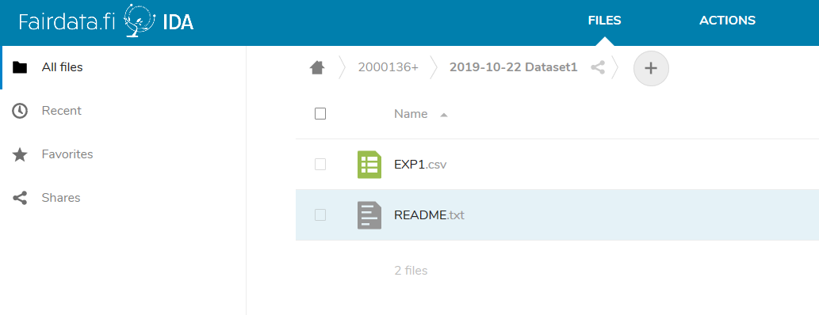
Storing the data in IDA 1/2 Adding data
Researcher uploads the data to their project’s staging area
Other project members can view, edit and download the data

Slide 8
Storing the data in IDA 2/2 Freezing the data
Researchers freezes the data: this makes it read-only, and makes it possible to publish the data later
Frozen data is still visible to project members only

Slide 9
Tips for IDA users
You can use IDA for a longer period of time to collect and finalize your data.
IDA enables sharing data within a project group, and you can have project members from multiple organisations & from abroad.
You can also share data with anyone with IDA's temporary share links.
If you're computer-savvy and you have large files or a big amount of data (or you wish to move data from e.g. Puhti to IDA) use IDA's command line tools https://www.fairdata.fi/en/ida/user-guide/#command-line-tools

Slide 10
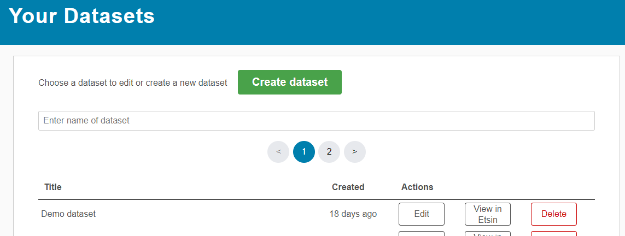
Describing the dataset 1/4 Login
Researcher logs into Qvain Light. Qvain Light is a tool for describing and publishing datasets.

Slide 11
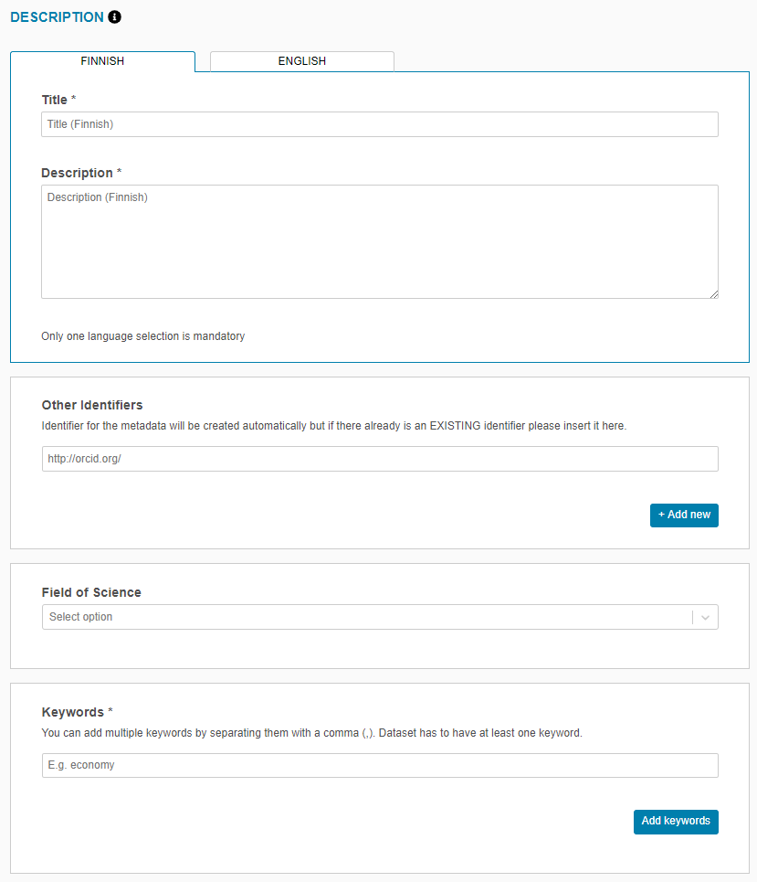
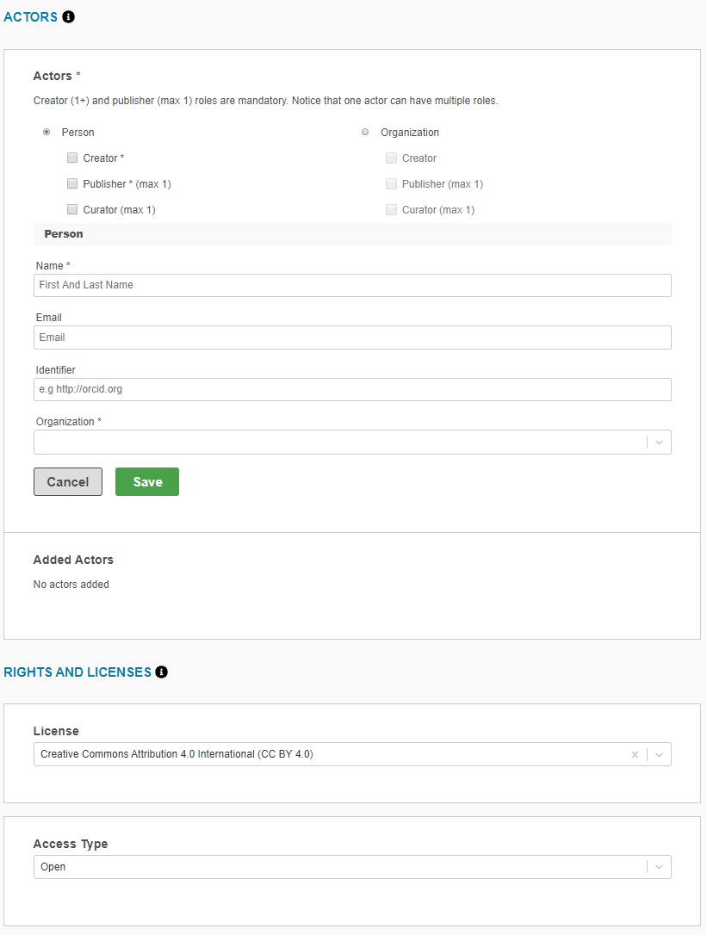
Describing the dataset 2/4 Adding the metadata
The researcher fills in the required metadata.
Title *
Description *
Other identifiers
Field of Science *
Keywords *
Actors *
License *
Access Type *

Slide 12
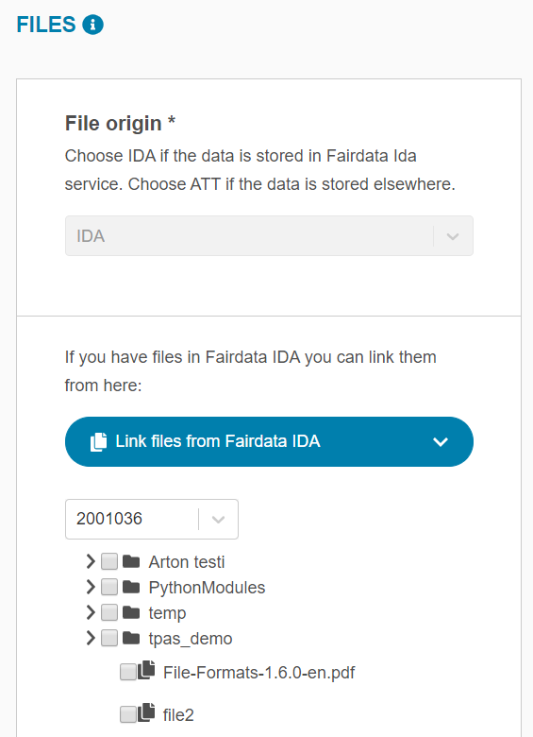
Describing the dataset 3/4 Selecting data for the dataset
A list of FROZEN files is shown in the form.
After selecting the data, the researcher publishes the dataset.

Slide 13
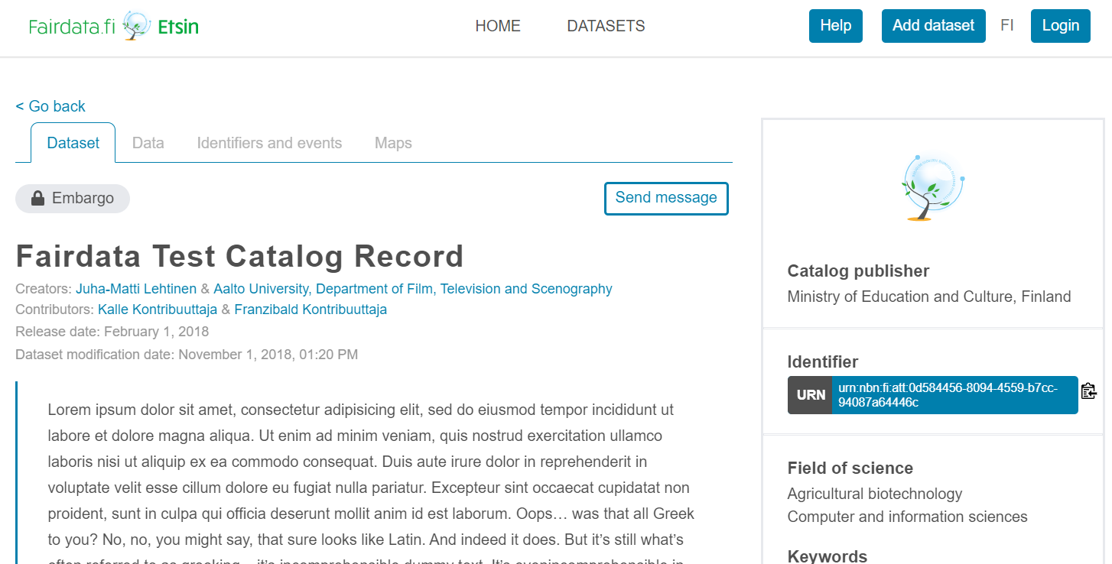
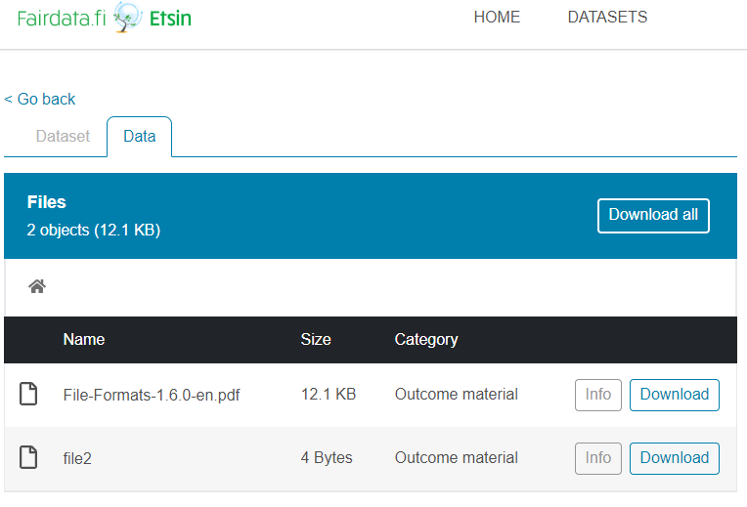
Describing the dataset 4/4 Publishing the dataset
After the dataset is published it’s visible in Etsin and it has a persistent identifier (DOI / URN)
Data is now downloadable through Etsin (based on Access Type selection)

Slide 14
Tips for Qvain Light users
Qvain Light:
You can edit your dataset later if you wish to add more metadata or make corrections. Editing just the metadata with Qvain Light doesn't create a new version, but if you change the files associated to the dataset, a new version is created automatically.
You can also create a cumulative (growing) dataset, which means that you can add more files to it from IDA without creating a new version.
Using Metax API instead of Qvain:
If you have lots of datasets to publish & you're computer-savvy, you might be interested in creating your dataset descriptions with Metax REST API, read more https://metax.fairdata.fi/docs/

Slide 15
General tips for Fairdata users
What is metadata and documentation, what is usually included and why: https://research.csc.fi/metadata-and-documentation
What is a persistent identifier, why is an URN/DOI needed for research data: https://research.csc.fi/identifiers-and-dataset-versioning
Check what kinds of files names and formats are recommended when storing/sharing research data: https://research.csc.fi/files-and-file-formats
Fairdata is not for publishing sensitive data, read more about sensitive data services: https://research.csc.fi/sensitive-data
Get an overall picture of data management: https://www.fairdata.fi/en/why-fairdata/data-management-checklist/
Data management planning
We recommend the Tuuli data management planning tool for creating a data management plan. Its been developed by Finnish research organization network.
Research funders require making a plan for managing your data.

Slide 16
More information
More information about the services: https://www.fairdata.fi/
Support for users and organizations available at servicedesk@csc.fi
Useful links:
https://www.fairdata.fi/en/faq/
https://www.fairdata.fi/en/a-fairydata-service-user-tale/
This slideshow is available at:
https://www.fairdata.fi/en/materials/

