Slide 1
Good Data Management and CSC Services
CSC's services for different stages of the research data life cycle, Webinar 7.5.2020

Slide 2
Non-profit state organization with special tasks
Turn over in 2019
51
M€
Headquarters in Espoo, datacenter in Kajaani
Owned by state (70%)
and all Finnish higher education institutions (30%)
Circa
395
employees in 2019
Notes:
CSC tuottaa kansainvälisesti korkeatasoisia asiantuntijapalveluita tutkimukselle, koulutukselle, kulttuurille, julkishallinnolle ja yrityksille, niin että ne voivat menestyä ja tuottaa etua koko yhteiskunnalle. Olemme edelläkävijä tiedonhallinnassa ja tietojärjestelmien yhteentoimivuuden tekijänä. Tarjoamme tiedeyhteisön käyttöön myös Suomen tehokkaimman laskentaympäristön, huippunopeat ja luotettavat tietoliikenneyhteydet sekä tieteen tietotekniikan asiantuntijat ja palvelut. CSC on erityistehtäväyhtiö, josta asiakas saa tarpeisiinsa täsmälleen oikein mitoitetut ratkaisut. Maailmanluokan palvelut ja ainutlaatuiset verkostot auttavat asiakkaitamme menestymään kansainvälisessä kilpailussa ja keskittymään huoletta omaan ydintoimintaansa. Teemme työmme tiiviissä yhteistyössä asiakkaidemme kanssa, voittoa tavoittelematta. Kannamme vastuuta Suomen pysymisestä kehityksen kärjessä!

Slide 3
Our customers
Researchers, research institutes and organizations
Organizations providing education
Memory organizations, state and public organizations

Slide 4
CSC’s solutions
Computing and software
Solutions for managing and
organizing education
Hosting services tailored to customers’ needs
Data management and analytics for research
Solutions for learners and teachers
Identity and authorisation
Support and training for research
Solutions for educational and teaching cooperation
Management and use of data
ICT platforms, Funet network and data center functions are the base for our solutions
Research administration
Notes:
Tutkimushallinnonpalveluihin kuuluu mm
VIRTA-tietovarantopalvelut
Bibliometriikka-palvelut
ORCID-tutkijantunniste-koordinaatio
Koulutuksen johtamisen ja järjestämisen palveluihin kuuluu mm.
Vipunen
Koulutustoimialan ohjauksen tukipalvelut (OIVA, KOTA Extranet)
Oppijan ja opettajan palveluihin kuuluu mm.
Digitaalinen oppiminen (EXAM, Funet Tiimi, Funet Etuubi Kaltura)
Oppijan sähköinen asiointi (OILI, OODI, EMREX, JOOPAS, PURO)
Opetus- ja koulutusyhteystyöhön kuuluu mm.
Joustavat opintopolut (EMREX, OILI, JOOPAS, PURO)
Yhteistyöalustat ja tiedostonjako (Eduuni, FUNET File Sender)
Verkkovierailupalvelut (Eduroam)
Räätälöityihin käyttöpalveluihin kuuluu mm.
Palvelinalusta- ja käyttöpalveluratkaisut (Tilastokeskuksen FIONA, Finna, kirjastokonsortiot)
Kansallisen audiovisuaalisen instituurin käyttöpalvelut (KAVI)
Tiedonhallinnan ja hyödyntämisen palveluihin kuuluu mm.
Tiedon pitkäaikaissäilytyksen palvelut (PAS)
Tietotuotannon ja tiedolla johtamisen palvelut (Kuntatieto, Kuntatalouden tietopalvelu, Valtiokonttorin raportointi)
Identiteetti- ja käyttövaltuuspalveluihin kuuluu mm.
Identiteetin hallinta(Haka, Virtu, Eduuni-ID, MPASS)
Käyttövaltuuksien ja luvituksien hallinta (REMS)

Slide 5
Good Data Management

Slide 6
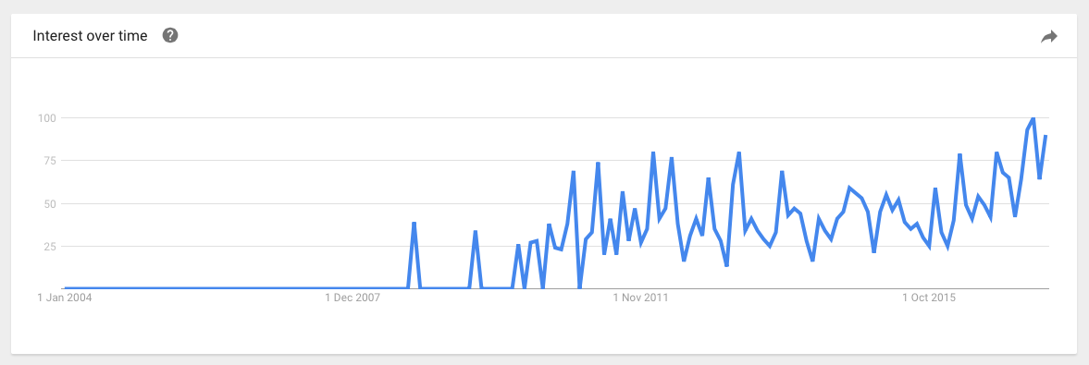
What’s so special about data?
““Data is the new oil. It’s valuable, but if unrefined it cannot really be used. It has to be changed into gas, plastic, chemicals, etc to create a valuable entity that drives profitable activity; so must data be broken down, analyzed for it to have value.”– Clive Humby, mathematician
Lainauksen ja kuvaajan lähde: https://medium.com/project-2030/data-is-the-new-oil-a-ludicrous-proposition-1d91bba4f294

Slide 7
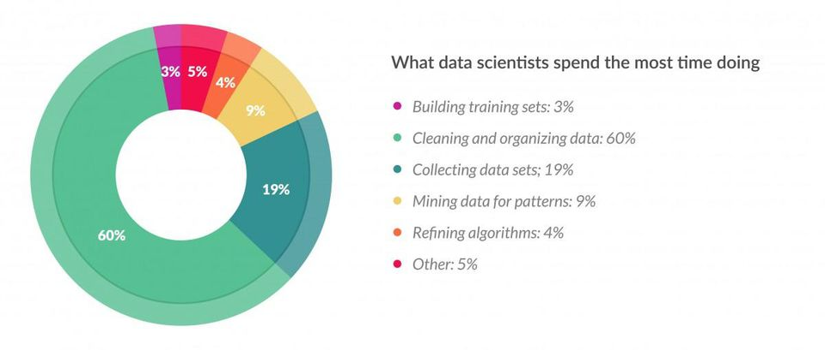
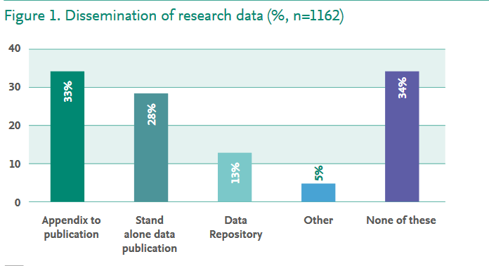
Two major bottlenecks: quality and accessibility
Lähde: https://www.forbes.com/sites/gilpress/2016/03/23/data-preparation-most-time-consuming-least-enjoyable-data-science-task-survey-says/#7b34677e6f63
Lähde: https://www.elsevier.com/about/open-science/research-data/open-data-report
Notes:
Miksi datasta ja datanhallinnasta on tullut niin kuumia keskustelunaiheita?
Maailmassa syntyy joka päivä, jopa joka minuutti, valtavia määriä dataa. Data on arvokas resurssi ja siksi sitä kutsutaan usein uudeksi öljyksi (tai valoksi, vedeksi, ydinvoimaksi, jne.). Yksi merkittävä dataa tuottava ja hyödyntävä toimiala on tutkimus. Tutkimusdatalla on suuri potentiaali katalysoida liiketoimintaa ja yhä uutta tutkimusta. Potentiaalin toteutumisen tiellä ovat datan heikko yhteentoimivuus ja epäluotettavat säilytysratkaisut. Erään kyselyn tulosten perusteella dataintensiivisessä tutkimuksessa jopa 80% ajasta kuluu ns. data wrangling –työhön, eli erilaiseen datan valmisteluun. Parantamalla datan yhteentoimivuutta ja erityisesti kuvailutietojen laatua, tutkimustoimintaa voitaisiin tehostaa merkittävästi. Toisen kyselyn perusteella vain 13% tutkijoista on tallettanut dataansa data-arkistoihin, jossa se olisi muiden saavutettavissa ja uudelleenkäytettävissä, ja jossa sen säilyvyys olisi turvattu.

Slide 8
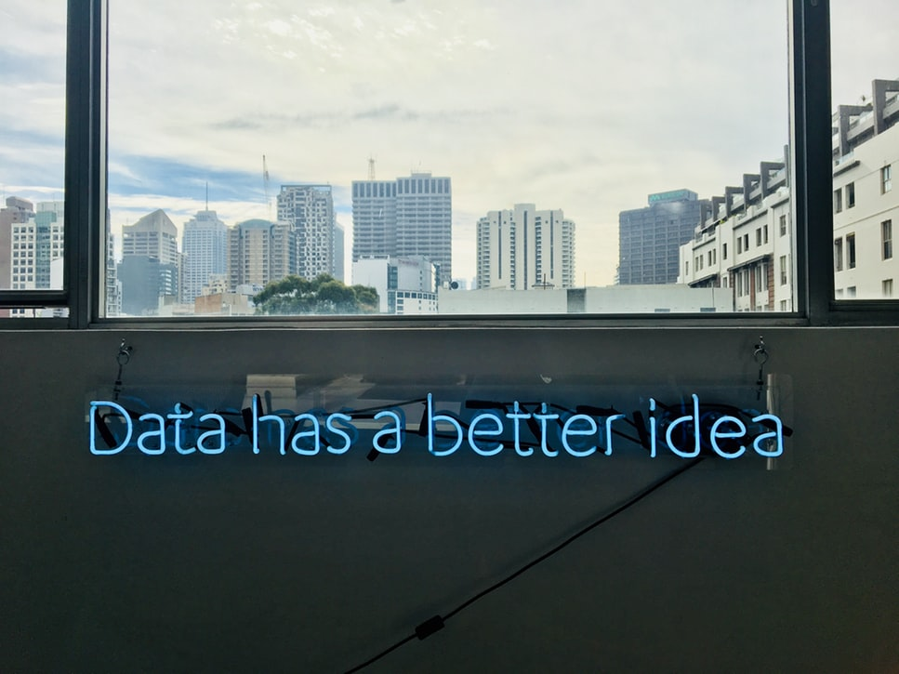
Understanding data key to CSC services
Recognising and understanding data related information and workflows is the key to harnessing the full potential of CSC services.
Digitalization is about data. New digital fronteers, such as machine learning and Internet of Things, are based on good quality data.
Notes:
Digitalisaatiossa on kyse muustakin kuin datasta, samoin kuin CSC:n palveluissa, mutta datan ymmärtäminen on avain sekä digitalisaation hyötyjen valjastamiseen että CSC:n palvelujen täysimittaiseen hyödyntämiseen. Siksi tarkastelemme tänään datan elinkaarta TKI-projektissa.

Slide 9
Don’t ask what is data, but WHEN is data
Kuvat Unsplash palvelusta CC0-lisenssillä

Slide 10
Research data types
DYNAMIC RESEARCH DATA
Version controlled, possible to cite
ACTIVE DATA
Raw, continuously updated
Documentation, validation
Research
RESEARCH DATASET PUBLICATION
Immutable

Slide 11
All you need is love (and metadata)
Metadata, you see, is really a love note – it might be to yourself, but in fact it’s a love note to the person after you, or the machine after you, where you’ve saved someone that amount of time to find something by telling them what this thing is.
– Jason Scott
Lähde: https://www.ontotext.com/knowledgehub/fundamentals/metadata-fundamental/

Slide 12
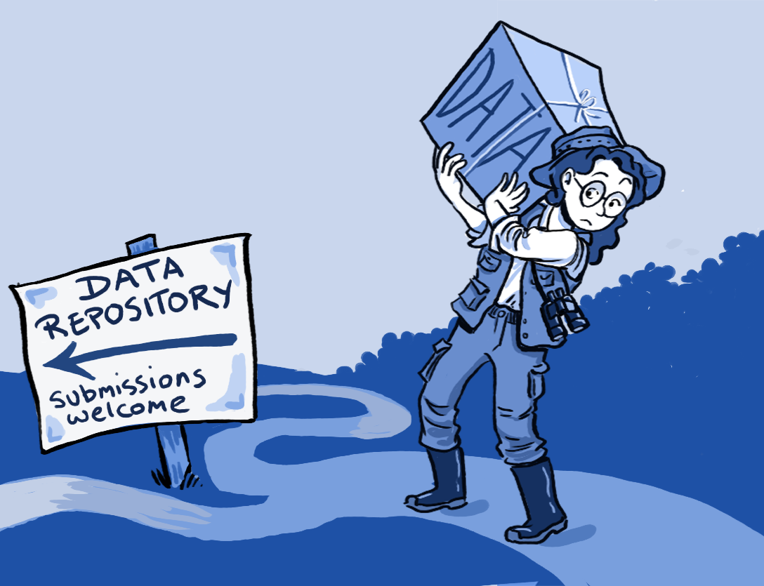
Data management
Data management is a set of practices to handle collected and created information. It consists of a wide range of practices, concepts, procedures, processes, policies, and of accompanying systems. It enhances the value of data by making it interoperable, easier to find and understand, less likely to be lost, and more likely to be used and reused during original use and beyond. Data management practices involve, but are not limited to, data management planning, documentation, organization, storage, dissemination, preservation, and if need be, deletion. Effective data management is an ongoing process which is structured and aligned with the use context and life cycle stages.
Picture source: https://www.openaire.eu/images/easyblog_articles/1120/Registry-of-Research-Data-Repositories.png

Slide 13
“The machine knows what I mean.” – Barend Mons, President of CODATA, one of the originators of FAIR principles

Slide 14
F
Described in a suitable metadata catalogue, using rich metadata
A
Accessible through internet
I
Uses common, documented, and open formats and standards
R
Has versioning and lifecycle documentation
Has tombstone page if deleted
Is richly documented and understandable
Has a landing page and (persistent) identifier
Has clear information about conditions for reuse
FINDABLE
ACCESSIBLE
FAIR ENOUGH?
INTEROPERABLE
REUSABLE
Notes:
Pysyvä tunniste on lupaus, joten sellaisen määrittäminen aineistolle edellyttää tiettyä harkintaa.

Slide 15
As open as possible, as closed as necessary
Legitimate reasons to limit openness
Contractual obligations
Personal data protection
Data subjects personal reasons and preferences
National interests
Judicial reasons
Environmental reasons
Copyright
Reasons based on protecting cultural heritage and related rights
Permission granted only for research purposes
Permission granted only for educational purposes
Other reasons – List is not exhaustive!

Slide 16
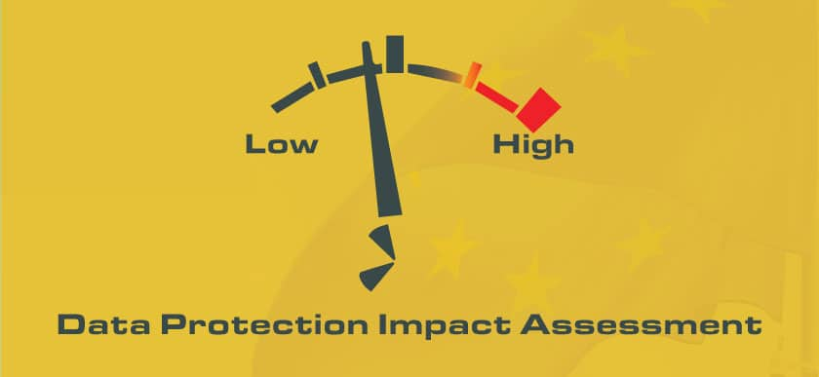
Sensitive data
Not just personal data, not all personal data
Any information, that you want to protect from illegitimate access is sensitive
GDPR special category data
Race and ethnic origin.
Religious or philosophical beliefs.
Political opinions.
Trade union memberships.
Biometric data used to identify an individual.
Genetic data.
Health data.
Data related to sexual preferences, sex life, and/or sexual orientation.
https://tietosuoja.fi/en/processing-of-special-categories-of-personal-data

Slide 17
Organizing research data management support
§
@

Slide 18
CSC data policy
Principles
1. Data ownership is clear and management responsibilities agreed upon. 2. Data are documented and their lifecycle defined. 3. Data publicity and protection are managed appropriately. 4. Data are made as open and as interoperable as possible. 5. Data management solutions favor open standards, protocols and software. 6. Data management competencies are recognized and developed in order to support these principles and their implementation.
Read the policy in full: https://www.csc.fi/en/data-policy

Slide 19
CSC services throughout the research project life cycle

Slide 20
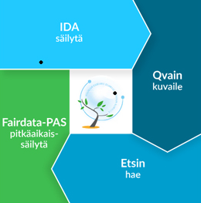
Planning
Co-operation
Data storage & sharing
Dissemination
Reporting
Analysis
Research.fi
Research project lifecycle
cPouta
ePouta
PUHTI

Slide 21
Planning
Data management planning tool DMPTuuli helps you to create, review, and share data management plans that meet institutional and funder requirements.
You can download funder templates without logging in, but from DMPTuuli you will find tailored guidance from many research organisations, including universities and service providers.
https://www.dmptuuli.fi/
0€

Slide 22
Co-operation
Eduuni is a collaboration service environment for flexible and secure collaboration across organisation and ecosystem boundaries.
Eduuni Services:
Eduuni-workspaces (Microsoft SharePoint, OneDrive ja Office Online)
Eduuni-wiki (Atlassian Confluence)
Eduuni-jira (Atlassian Jira)
The Funet FileSender is an easy-to-use, browser-based file sharing service. With Funet Filesender, you can transfer and share files up to several gigabytes in size. based on the open-source FileSender application specially developed for higher-education institutions and research communities. The service is available to all Funet organisations included in the Haka user identification system. Funet FileSender is not intended for the permanent storage of files; all files are deleted after a predetermined period of time.
https://filesender.funet.fi/
€

Slide 23
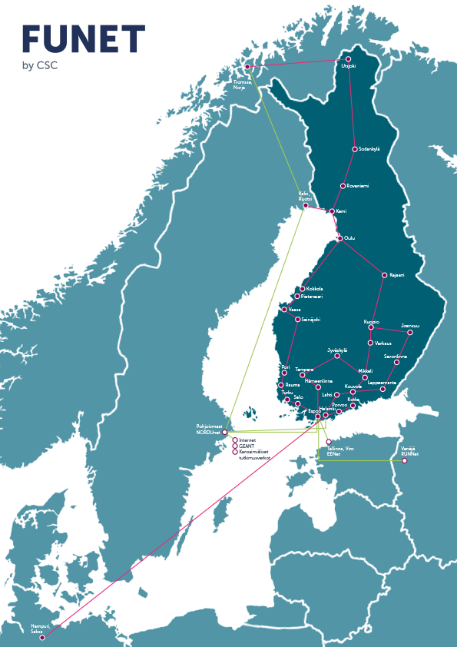
Funet – National and International Networks and Services
Services included in Funet membership
Funet Network Connections
Funet CERT Information Security Services
Vulnerability Scanner
Certificate Service
eduroam Roaming Access Service
Funet FileSender File Sharing Service
Services with additional costs
Funet Etuubi Video Management System
Funet Silta Video Conferencing MCU Service
Funet Tiimi Web Conferencing System
Funet light Paths
Router Service
Streaming Service
Approx.
80
Funet members
370 000
endusers

Slide 24
Service for sensitive data
Datan management and analysis solution primarily for sensitive human data
Piloting on going, in production later this year, usage policy not yet determined
User submits data to the service
Access to data through ePouta remote desktop
Data owner controls access
We encrypt the data and store in securely
Data is available for processing without the need to migrate or copy to another location
Partners can see unencrypted read only version of data
Access right can be temporary and revoked at any time by data owner

Slide 25
Analysis
Puhti is a supercomputer that caters to a wide range of use cases. Puhti allows the user to run anything from interactive single core data processing to medium scale simulations spanning multiple nodes. Puhti GPU partition is suitable for all kinds workloads capable of utilizing GPUs, even heavy AI models that span multiple nodes. Puhti has wide selection of scientific software installed.
cPouta and ePouta are Infrastructure as a Service (IaaS) cloud computing services. Both can be accessd through a web interface. The main difference is that ePouta is designed for sensitive data. The infrastructure consists of virtual machines (instances), block devices that can be attached to virtual machines (volumes), virtual networks that can be used to connect virtual machines, and in the case of cPouta, floating IP addresses that can be attached to virtual machines to make them accessible from the wider internet.
Notebooks is an easy-to-use environments for working with data and programming especially suited for running training courses.
PUHTI
0€
cPouta
ePouta

Slide 26
Datan storage & sharing
The EUDAT – European Data Infrastructure – is a research data infrastructure initiative co-funded by the European Commission. EUDAT has built a suite of five integrated services: B2SHARE, B2SAFE, B2STAGE, B2FIND, and B2DROP. CSC coordinates EUDAT.
Allas object storage is a new storage service for all CSC computing and cloud services. It’s meant for data during project lifetime. Data can be stored and retrieved directly from anywhere on the internet, f.e. CSC supercomputers, local workstation, and measurement devices. Data is stored as objects within a bucket. There’s only one level of hierarchy of buckets (no folders within folders)
€
0€
Notes:
Deafault quota is 1 terabite and you can apply

Slide 27
IDA - Store
IDA provides safe storage for research data.
Etsin - Find
Etsin is a research data finder that contains descriptive information – metadata – on research datasets. Anyone may browse and use the metadata.
Qvain - Describe
Qvain metadata tool helps to add metadata that fulfills the minimum requirements for digital preservation. Quality metadata keeps the data findable and linkable and ensures that Fairdata services are interoperable.
Digital Preservation Service for Research Data - Preserve
Digital Preservation Service for Research Data takes care of the digital preservation of research outputs. Digital preservation is the reliable storage of digital information for tens or even hundreds of years.
Dissemination
0€

Slide 28
Dissemination
In the Library of Open Educational Resources (OER), you can search for and share open educational resources from all levels of education. Gradually introduced from 2019 to 2020, the service and its OER are available for use by teachers, learners and everyone else. The service is being developed by the Ministry of Education and Culture and the Finnish National Agency for Education, and its development is coordinated by CSC.
0€

Slide 29
Reporting
Tutkimustietovaranto kokoaa ja välittää tietoja esimerkiksi julkaisuista, tutkimusaineistoista, tutkimusinfrastruktuureista, tutkijoista ja tutkimushankkeista. Tutkimusta kuvaavia tietoja käytetään tutkimustyössä ja tutkimukseen liittyvässä hallinnollisissa prosesseissa, esim. tiedonhauissa, rahoitushauissa ja -raportoinnissa, julkaisutoiminnassa, tilastoinnissa ja muussa tutkimustiedon levittämisessä. Tutkimustietovarannon research.fi-portaali julkaistaan kesäkuussa 2020.
Justus on ammattikorkeakouluille kehitetty palvelu julkaisutietojen keräämiseen. Yhdistettynä Tutkimustietovarantoon Justusta voi hyödyntää tutkimustietojärjestelmänä (CRIS), joka helpottaa ja automatisoi tutkimustuotteiden seurantaa ja raportointia organisaatiossa.
0€
Tutkimustietovaranto
€

Slide 30
Csc.fi/training Information about trainings and events, materials from past events
Fairdata.fi
Tips and guidance for data management and info about Fairdata services.
My.csc.fi Portal for applying resources to computational and data storage services.
Docs.csc.fi Service manuals.
Find the right service
and how to use it

Slide 31
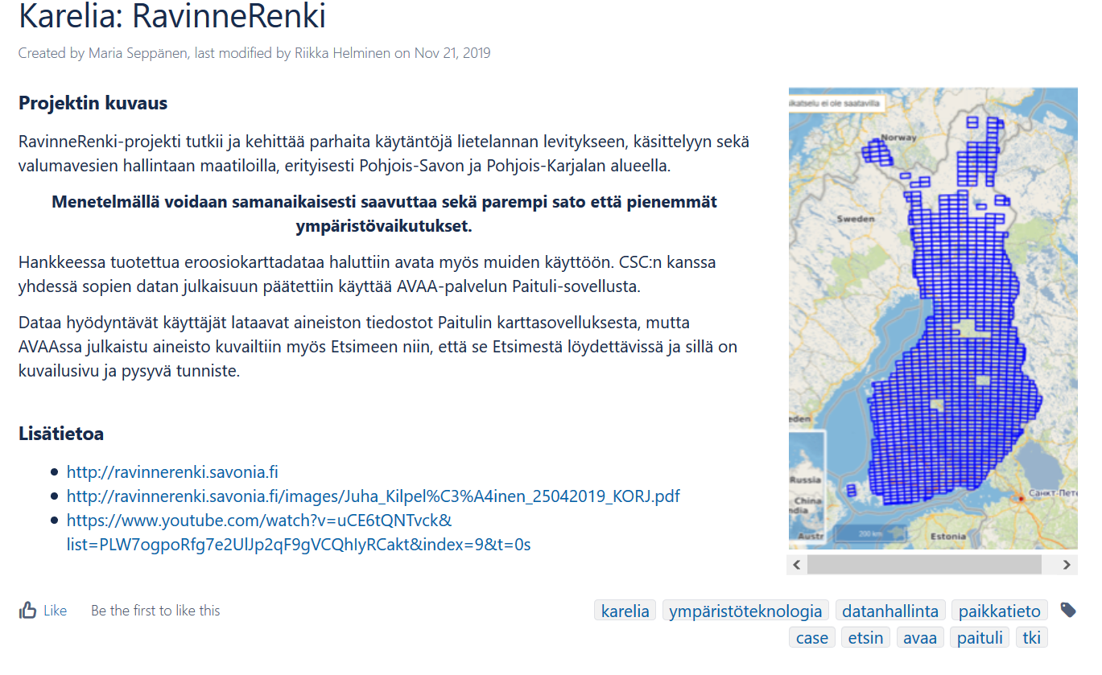
Service application examples wiki
https://wiki.eduuni.fi/x/TySeBw

Slide 32
CSC and COVID-19
Majority of CSC’s staff is working remotely, services are available and running as normally
CSC has prioritized COVID-19 related research in our services, such as high performance computing. If you work with a COVID-19 related research topic and want to know more, please contact servicedesk@csc.fi.
Funet Miitti (Zoom) FAQ: https://wiki.eduuni.fi/display/csckorkeakoulut/Funet+Miitti+%28Zoom%29+FAQ
More information:
https://www.csc.fi/koronavirusinfo
Korkeakoulutusta ja tutkimusta tukevat palvelut poikkeustilanteessa

Slide 33
Let’s talk!
HEIDI LAINE
Asiakasratkaisupäällikkö
Datanhallinnan palvelut
CSC - IT CENTER FOR SCIENCE LTD.
Keilaranta 14, P. O. Box 405,
FI-02101 Espoo, Finland
Tel. +358 40 513 95 93
heidi.laine@csc.fi
www.csc.fi

