Slide 1
Research data management and digital preservation
11.9.2020 | Jonas Tana | jonas.tana@csc.fi

Slide 2
Manage well and get preserved! -series
For whom?
  Data support personnel and researchers interested in digital preservation
Why?
  To give concrete support on how the data should be managed before digital preservation
  To learn about data and metadata formats, quality, PIDs, standards etc.
  Understand how the preservation service and process works in Finland
What?
  Series of seven webinars / videos (more information on next slide)
  All the recordings / videos will be available for open use and distribution
When?
  The series will be produced by Summer 2021

Slide 3
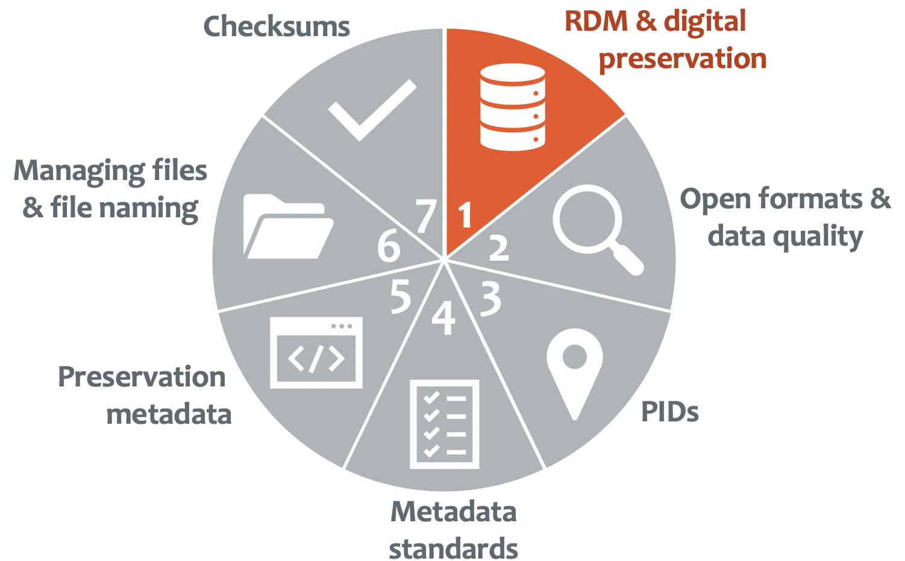
Manage well and get preserved! -series:
Research data management and digital preservation
  What is digital preservation? How should the data be documented and licensed before preservation? How the preservation service and process works in Finland?
Open formats and data quality
  Open formats, evaluation of formats, criteria
PIDs
  PIDs in the Fairdata Services, Research dataset PIDs, DataCite Finland
Metadata standards for research data
  DataCite, MetaShare CMDI, FAIRsharing, etc.
Preservation Metadata
  PREMIS
Managing files and file naming
  Good practices in organising your data, naming files and file formats
Checksums
  What they are and why and how they are used?

Slide 4
What is research data management?
Research data management (RDM) includes all parts of the research data life cycle, from it’s birth, initial storage and active usage to (long term) preservation or, if data becomes obsolete, deletion.
The aim of RDM is to make the whole research process more efficient and to meet the needs and requirements of funders and legislation.
RDM is crucial for facilitating data sharing and ensuring the sustainability and accessibility of data in the long-term and re-use for future science.
Proper RDM is an essential part of good scientific practice and the basis of successful research, as well as a key component of research integrity and reproducibility.

Slide 5
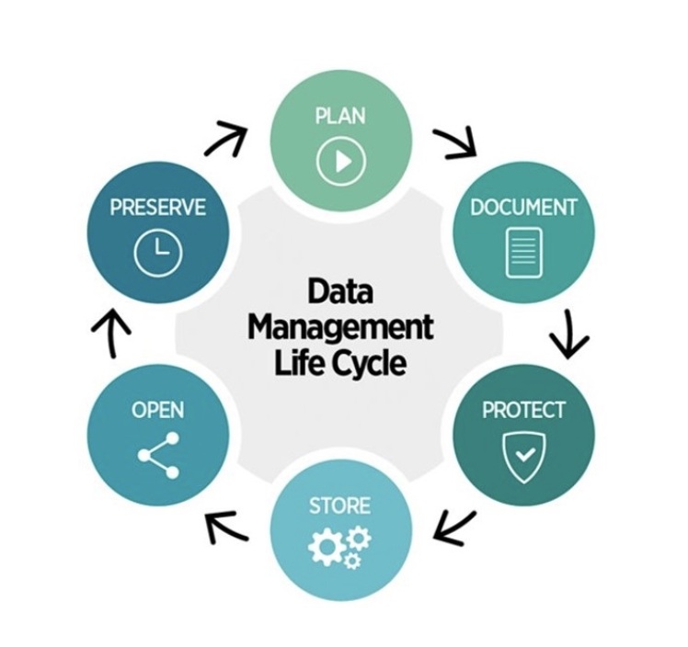
Research data management life cycle
CC-BY University of Helsinki Data Support.

Slide 6
Digital preservation
Digital preservation refers to the reliable preservation of digital information.
The goal of a digital preservation system is that the information it contains remains accessible and usable to users over a long period of time = several decades or even centuries.
  ≠ long-term storage, which entails storage of the data exactly as it has been deposited, only guaranteeing data integrity on the bit level
Hardware, software, and file formats will become outdated, while the information must be preserved and remain understandable.
    requires active, ongoing monitoring, curation and taking measures to extend the data lifetime so that it stays usable for decades or even centuries
      measures include conversion of obsolete file formats, or various means to ensure data integrity and quality, keeping data readable and usable and protecting it from decay and damage in the long term.

Slide 7
Digital preservation service for research data in Finland
Research datasets (including data, publications, code, learning materials etc) are eligible for digital preservation if they are considered fundamental to national or institutional research activities, based on the organisations own evaluation, for instance based on:
  the dataset’s potential for reuse
  data generation or collection that has required a lot of resources that would be extremely difficult, costly, or impossible to reproduce
Digital Preservation Service for Research Data are offered and owned by the Ministry of Education and Culture (Minedu), and are produced, managed and further developed by CSC - IT Center for Science as part of the Fairdata services.

Slide 8
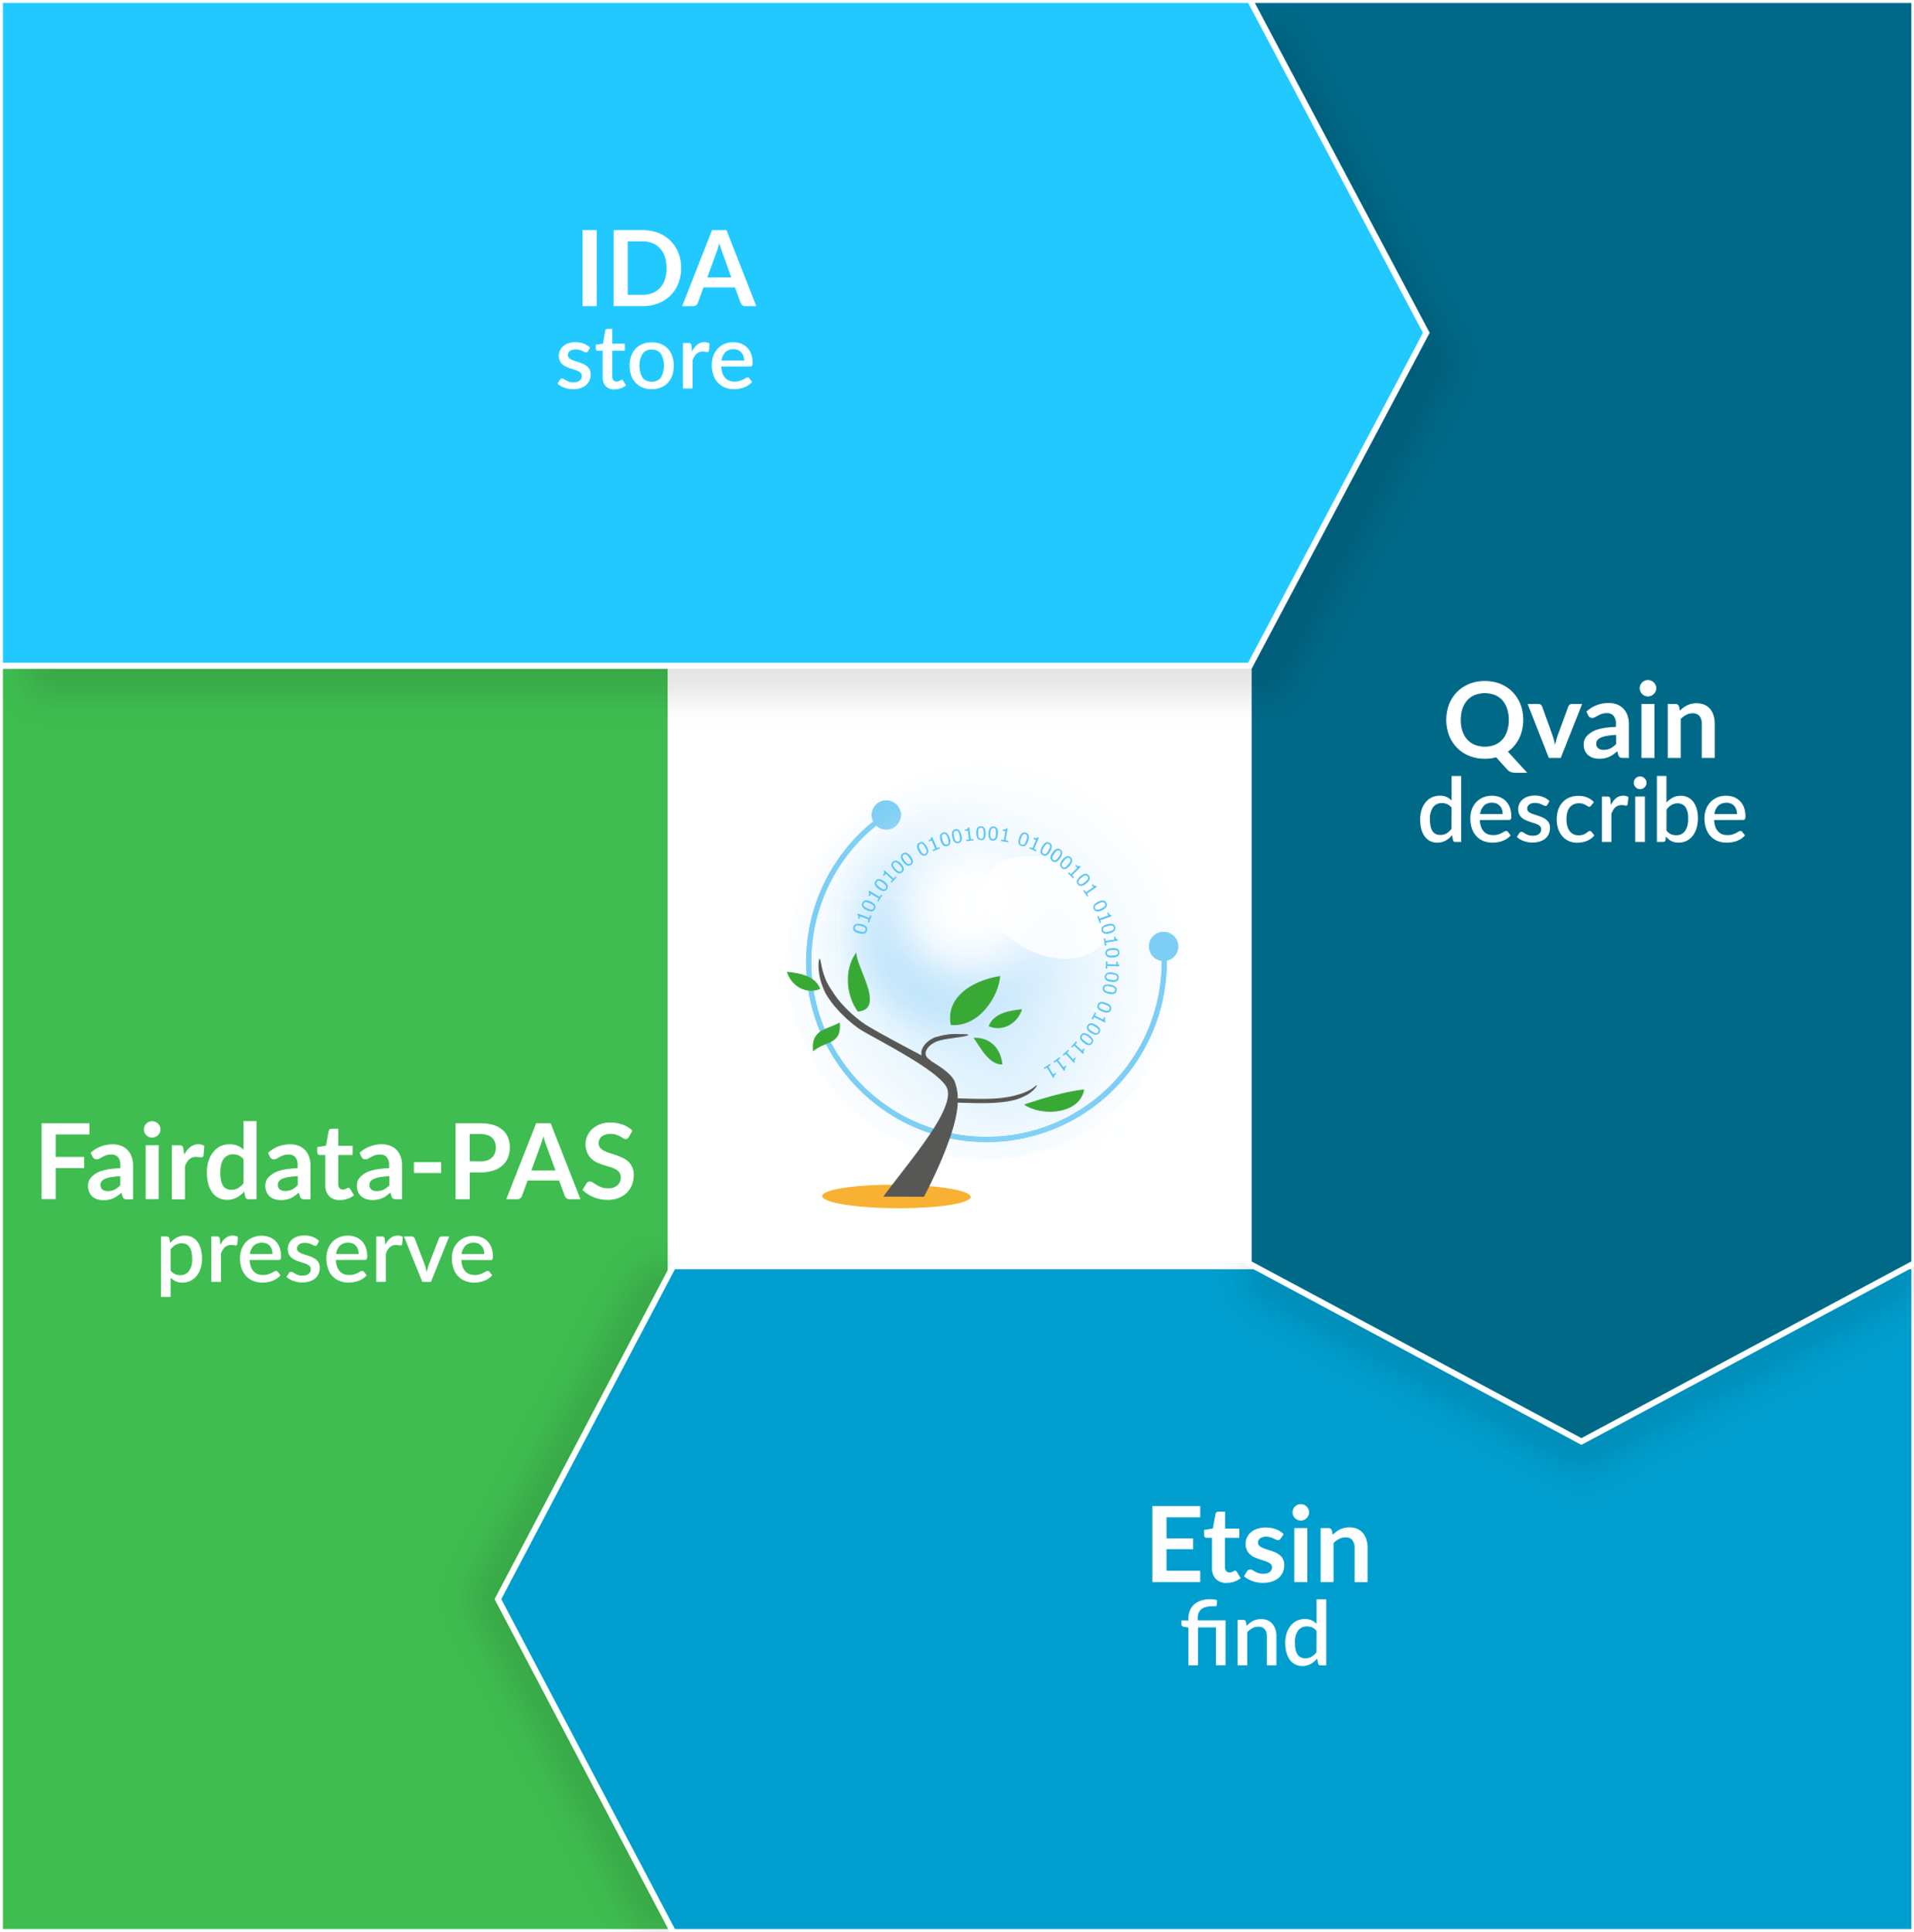
Fairdata Services
Part of the Fairdata services, which include:
  IDA (https://ida.fairdata.fi/)
    provides safe storage for research data
  Qvain (https://qvain.fairdata.fi)
    Tool that helps to add metadata that fulfils the minimum requirements for digital preservation and keeps the data findable and linkable and ensures that Fairdata services are interoperable.
  Etsin (https://etsin.fairdata.fi)
    Etsin is a research data finder that contains descriptive information – metadata – on research datasets.
  DPS for Research Data (http://www.digitalpreservation.fi)
    Digital Preservation Service for Research Data takes care of the digital preservation of research outputs. Digital preservation is the reliable storage of digital information for tens or even hundreds of years

Slide 9




Services, which
  help to make research data and related metadata Findable, Accessible, Interoperable, Re-usable
  focus on the later parts of data lifecycle, when data are becoming mature
Funders and research journals recommend or may even require access to research data
https://www.force11.org/group/fairgroup/fairprinciples
Produce research data
Save, rename, organize, share data
STORE the data in immutable state
DESCRIBE the data as a research dataset (add metadata)
Dataset (or just its metadata) is public, FINDABLE and citable (PID, landing page)
Copy dataset to DPS for Research Data for DIGITAL PRESERVATION (requires agreement)

Slide 10
Digital Preservation Service for Research Data at CSC
Digital Preservation Service for Research Data since 2019
Aim :
  Ensure the verifiability and repeatability of research in the long term
  Enable that research results can be:
    Reused, evaluated, utilized in decision-making, secured for future generations (of researchers)
  Ensure the availability and preservation of digital research resources
  Support a permanent and coordinated approach to support the management of research resources
The ownership of digital assets remain within the organisation which has preserved them

Slide 11




Different preservation levels
Content knowledge & semantics
Descriptive metadata
Semantic preservation
Partner organisations
Administrative & technical metadata
Digital preservation service
File formats
Preservation planning
Preservation actions
Logical preservation
Replication management
Storage media
Storage devices
Bit-level preservation

Slide 12
Digital Preservation Service (DPS) for Research data – how to and who does what?
Fairdata services, including DPS for Research Data, are offered free of charge to Finnish higher education institutions and research institutes.
To become a partner organisation with the DPS for Research Data:
  The organisation representative (Digital preservation contract contact person) proposes a dataset to be preserved to the Minedu by sending a request to the Minedu at fairdata-okm@postit.csc.fi. The message can include the Request document (in Finnish) as an attachment or the corresponding information in the email body
    Request document: https://www.fairdata.fi/en/about-fairdata/becoming-a-partner-organisation/
  Minedu will inform the organisation and CSC of its decision and grant a certain quota for the dataset. Contract between the organisation and CSC can be made in respect of the granted quota.
  CSC contacts the organisation representative and the contract is signed.
➡️ service utilisation can begin.

Slide 13
Becoming a partner of Digital Preservation
Ministry of Education and Culture
Agreement for deploying preservation service
Contract for providing national digital preservation service
Request for deploying preservation service
CSC – IT Center for Science
Partner Organization
Partner Organization
Partner Organization
Service contract for digital preservation service (for each partner organisation)

Slide 14
Request
Organisation’s formal
representative
Agreement on rights
Researcher
Minedu
Decision
contract
Service contract
Internal process
Data
support
Partner organisation
Organisation’s
IT support
CSC

Slide 15
Planning
Data collection and creation
Data storage & sharing
Publication
Analysis
Rights and licenses
Data flows and documentation
Formats, schemas
Services
GDPR and security
Support quality management
Support interoperability
Support metadata creation
Help using PIDs if needed
Data lifecycle
Support documentation
Support interoperability
Support workflow management
Support metadata creation
Ensure interoperability
Support security
Support rights management
Enable open access/access control
Preservation
Ensure rights
Follow internal process on assessment and contracts with Minedu and CSC
Ensure validation by researcher
Support creation of documentation
Support agreeing on rights and licences
Suggested role of data support
Internal collaboration and communication between the researcher and data support is crucial!

Slide 16
From collection to preservation
Digital preservation is an option for datasets, which have value for the organisation or on national level in the long term.
  Communicate within your organisation if you feel that data should be preserved -> contact your local data support.
Fairdata services provide various support functions for transferring material to digital preservation:
  if the material to be stored is in the Fairdata IDA service, the required metadata can be described with the Qvain tool.
  The material can then be transferred to the DPS for Research Data via a separate management interface.
  Metadata and file format requirements are described in digital preservation specifications that have been implemented in collaboration with utilizing organizations.

Slide 17
Data specifications
Preparing and packaging the digital assets is the most visible part of the digital preservation for partner organisations
Digital preservation services define the policies and technical specifications necessary for data preservation in collaboration with organizations. The information includes:
  Metadata: Sufficient metadata that make the data comprehensible
  File formats: File formats that are open and readable by more than one application and facilitate reuse of data
  Licensing: Clarification of ethical and legal issues such as IPR or personal (sensitive) data issues

Slide 18
Metadata
Metadata is information regarding the data, for example, where, when, why, and how the data were collected, processed and interpreted. Metadata may also contain details about experiments, analytical methods, and research context.
Metadata has a key role in digital preservation as it describes the information content, provenance information (“how this came to be”) and how the content can be used
Providing metadata enables you, and others, to make use of the data later
Metadata thus makes your data: understandable, discoverable, reusable

Slide 19
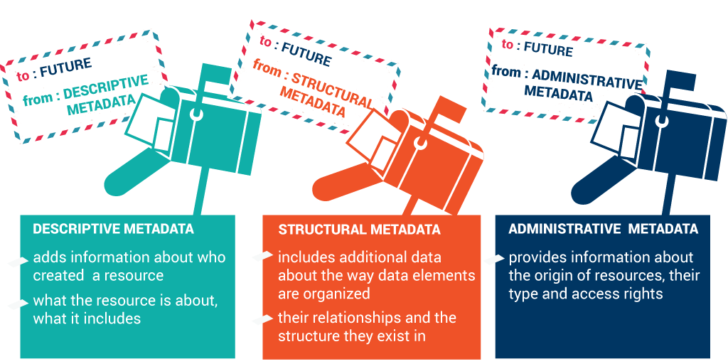
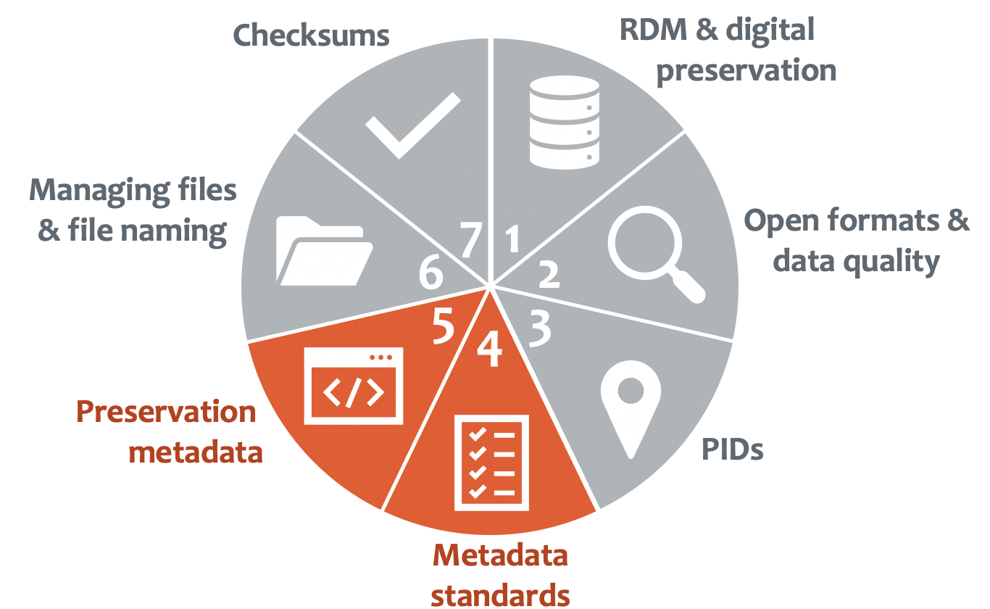
Different kinds of metadata
+ Technical metadata (file types etc.)
  Very essential for preservation
More on metadata in part 4 and 5 of the Manage well and get preserved! -series

Slide 20

Data licensing
Terms of use are usually easiest defined by a license, which allows you to specify the degree of publicity and user rights for your data.
  As a general rule, data can be used in accordance with its terms of use determined by the rights owner (as specified in the administrative metadata). You can always contact the owner of the data in order to clarify any uncertainties regarding the use of data
Creative Commons licenses are widely used for sharing and using data.
  CC BY 4.0 license allows the use of your data but require that the author is mentioned.
  CC0 license gives full rights to others for using your data
Data can thus be completely free or may be subject to certain restrictions (normally due to sensitive information, business secrets or other agreements)
NOTE! Data licensing does not change when transferred to DPS for Research Data

Slide 21
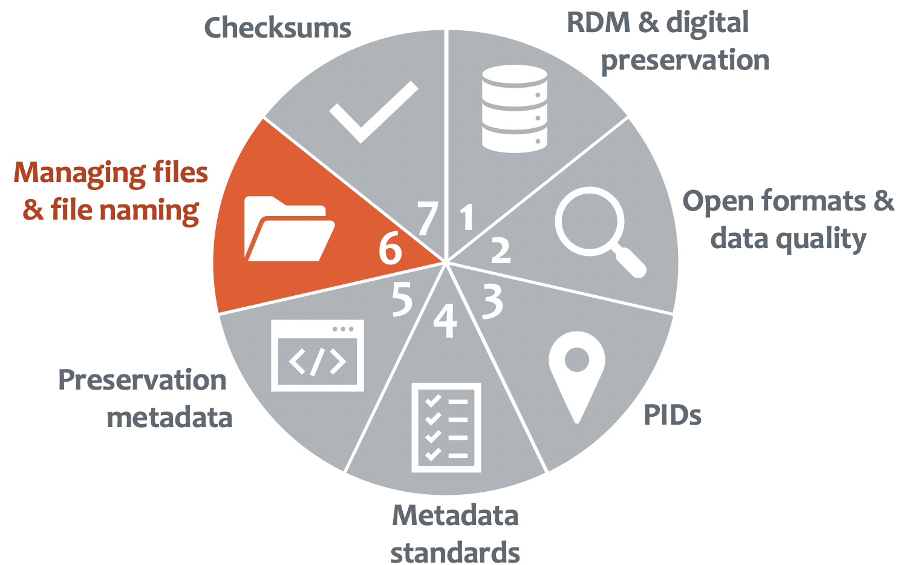
File formats
Limited set of file formats
  Mandatory approach for preservation
Specification for file formats specifies:
  Recommended file formats (32 formats)
  File formats acceptable for transfer (10 formats)
  Use of controlled vocabularies
  Requirements for technical metadata
Specifications are prepared in cooperation with partner organizations
For more detailed information: http://www.digitalpreservation.fi/en/specifications
More on managing files & file naming in part 6 of the Manage well and get preserved! -series

Slide 22
Digital preservation threats
Media Failure
  All storage media must be expected to degrade
Hardware failure
  All hardware components must be expected to suffer transient recoverable failures
Software failure
  All software components must be expected to suffer from bugs
Communication errors
  Network transfer will either succeed or fail
Failure of network services
  Anticipate that the external network services will suffer transient and irrecoverable failures
Media & Hardware obsolence
  All media and hardware components will eventually fail
Software obsolence
  Software components will become obsolete
Operator error
  Operator actions must be expected to include both recoverable and irrecoverable errors
Natural disaster
  Flood, fire and earthquake must be anticipated
External attack
  All systems connected to public networks are vulnerable to viruses and worms
Internal attack
  Anticipate insider abuse
Economic failure
  Budgets vary up and down over time
Organizational failure
  Organisations may die out
Rosenthal, D. S., Robertson, T. S., Lipkis, T., Reich, V., & Morabito, S. Requirements for digital preservation systems: A bottom-up approach. D-Lib Magazine 11(11), 2005.

Slide 23
Intelligibility, or loss of the meaning of content.
Digital information has to be preserved not only against hardware and software technology changes, but also against changes in the knowledge of the community = preservation of intelligibility ensures that the document is understandable to potential future users.
There is an ”easy” solution to this threat: metadata
  Metadata , literally “data about data”, represents all the information necessary to describe data.
  Enough descriptive metadata needs to be included so that the materials’ original context is preserved.
  Has to be preserved along with the data to ensure its intelligibility in the future.

Slide 24

Once preserved, then what?
Digital assets are retreivable for the managing organisation from the DPS for Research Data service when needed.
  For instance if the data has been corrupted within the organisation
Metadata for the digital assets are transferred to Etsin
  Available for harvesting
Your research data assets are stored and preserved for generations

Slide 25
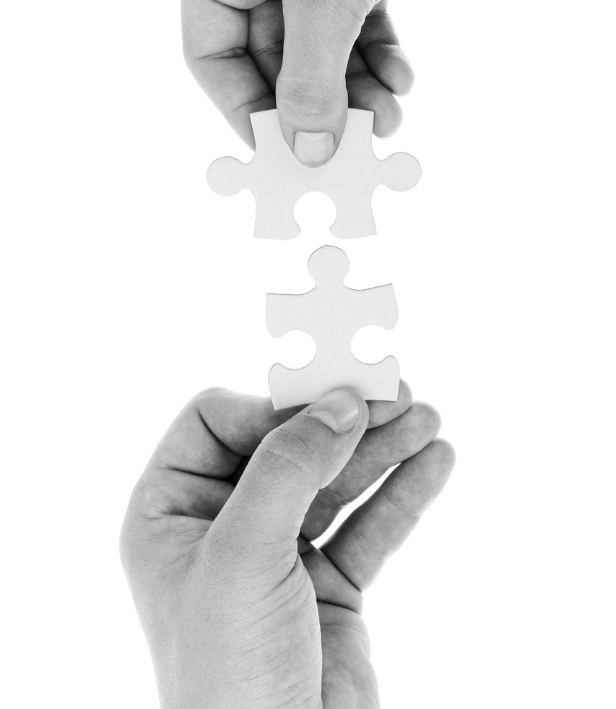
Key messages
Internal communication within your organisation and collaboration between researchers and data support is crucial
Researchers and data support work together on data documentation
NOTE! You are not alone
  For support on data management
    servicedesk@csc.fi
  For technical support in matters such as metadata and file specifications
    pas-support@csc.fi
Pixabay, CC0

Slide 27
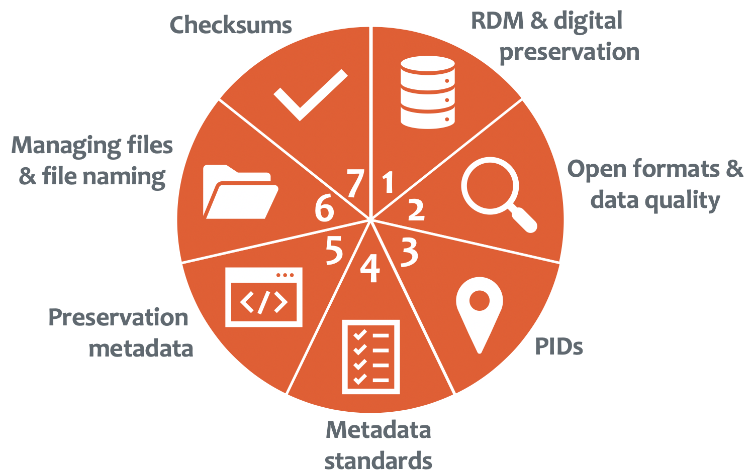
Thank you!
This webinar, as well as all other parts of the Manage well and get preserved! -series will be available on CSC´s YouTube data management playlist. The series will be produced by Summer 2021.

Slide 28

Questions?
Pixabay, CC0

Slide 29
Jonas Tana
jonas.tana@csc.fi
+358503244359
www.csc.fi

