Slide 1
Some tools you hear about when talking about reproducibility: git, containers, notebooks, workflows Maria Lehtivaara
23.4.2021 at CSC

Slide 2
Aim of this presentation
Give a brief idea of some common tools related to producing re-producable science
You recognise the tool and can map it to some context, know how to learn more
git
containers
notebooks
workflows
Disclaimers
These are NOT by any means exhaustive lists of all existing tools
These are NOT all tools maintained or supported by CSC
Except: CSC Notebooks, Chipster…

Slide 3
Bad vs better situation
Hey, can you check which parameters were used to get these results? Could we do this small modification?
Typing commands directly on the command prompt
Storing files in personal computer in random hierarchy
Having the softwares installed (only) in your own computer
Typing commands and comments to version controlled files, using automated workflows
Storing files in (public/joined) repositories
Having the softwares installed as documented containers
(…but PLEASE don’t ask me again after 5 years…)
Ummm… I had some results here on my laptop… and I THINK this was the laptop where I had the softwares installed…
Sure! Let me just check my repository, and we can re-run the needed sections in these containers!

Slide 4
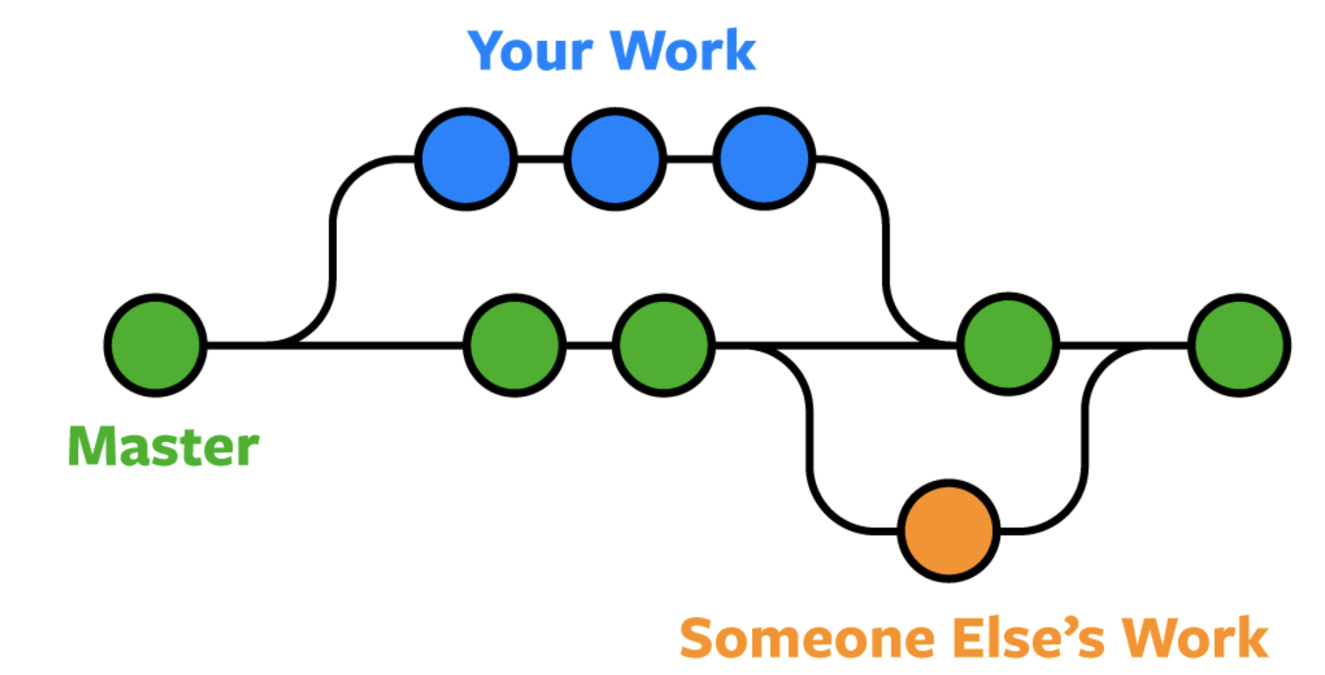
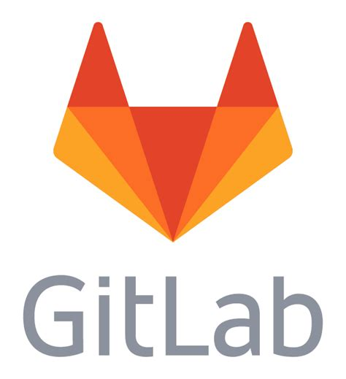
Git -what & why?
Used by developers / coders, but useful to anyone who writes code or needs to track changes to files => that’s almost everyone, right!
Tracks the changes you make to files
Allows to revert to specific versions (= recovery from “oopsies”)
Makes collaboration easier (allow changes by multiple people to all be merged into one source)
Normal folder Git repository Remote repository
Files Files + metadata for you Files + metadata for everyone*
(= team, company, everyone…)
Source: https://www.nobledesktop.com/blog/what-is-git-and-why-should-you-use-it
Notes:
https://github.com/hendricius/the-bread-code

Slide 5
Git –use cases
Developing analysis pipeline or tool –collaboration needed
Data analysis –”what did I do again? Did I test that already?”
Publications link to git repos containing everything needed to repeat the analysis
CSC’s user guides & course materials (feel free to use and develop!)
Normal folder Git repository Remote repository
archive & reference repositories
Files Files + metadata for you Files + metadata for everyone*
(= team, company, everyone…)
Check these:
https://guides.github.com/activities/citable-code/
https://www.softwareheritage.org/save-and-reference-research-software/

Slide 6
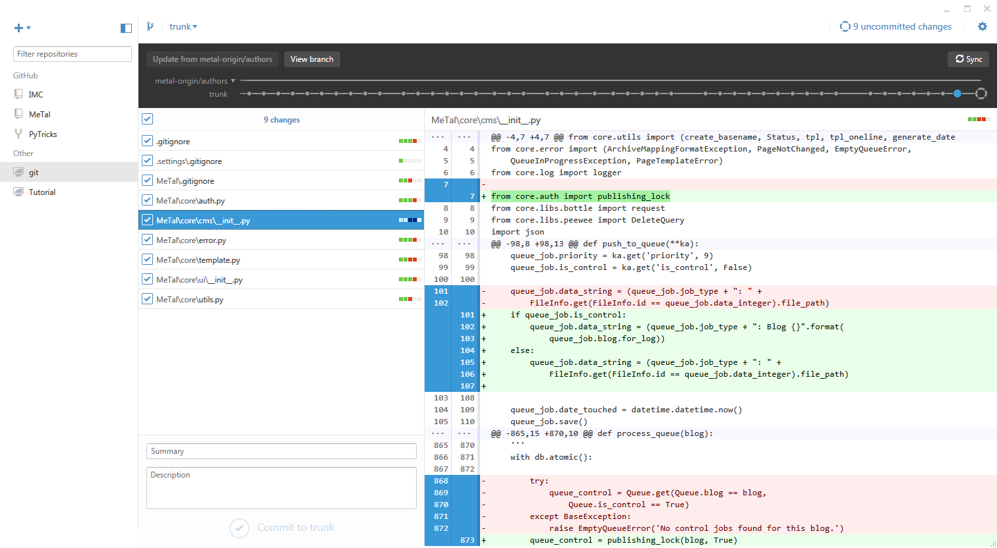
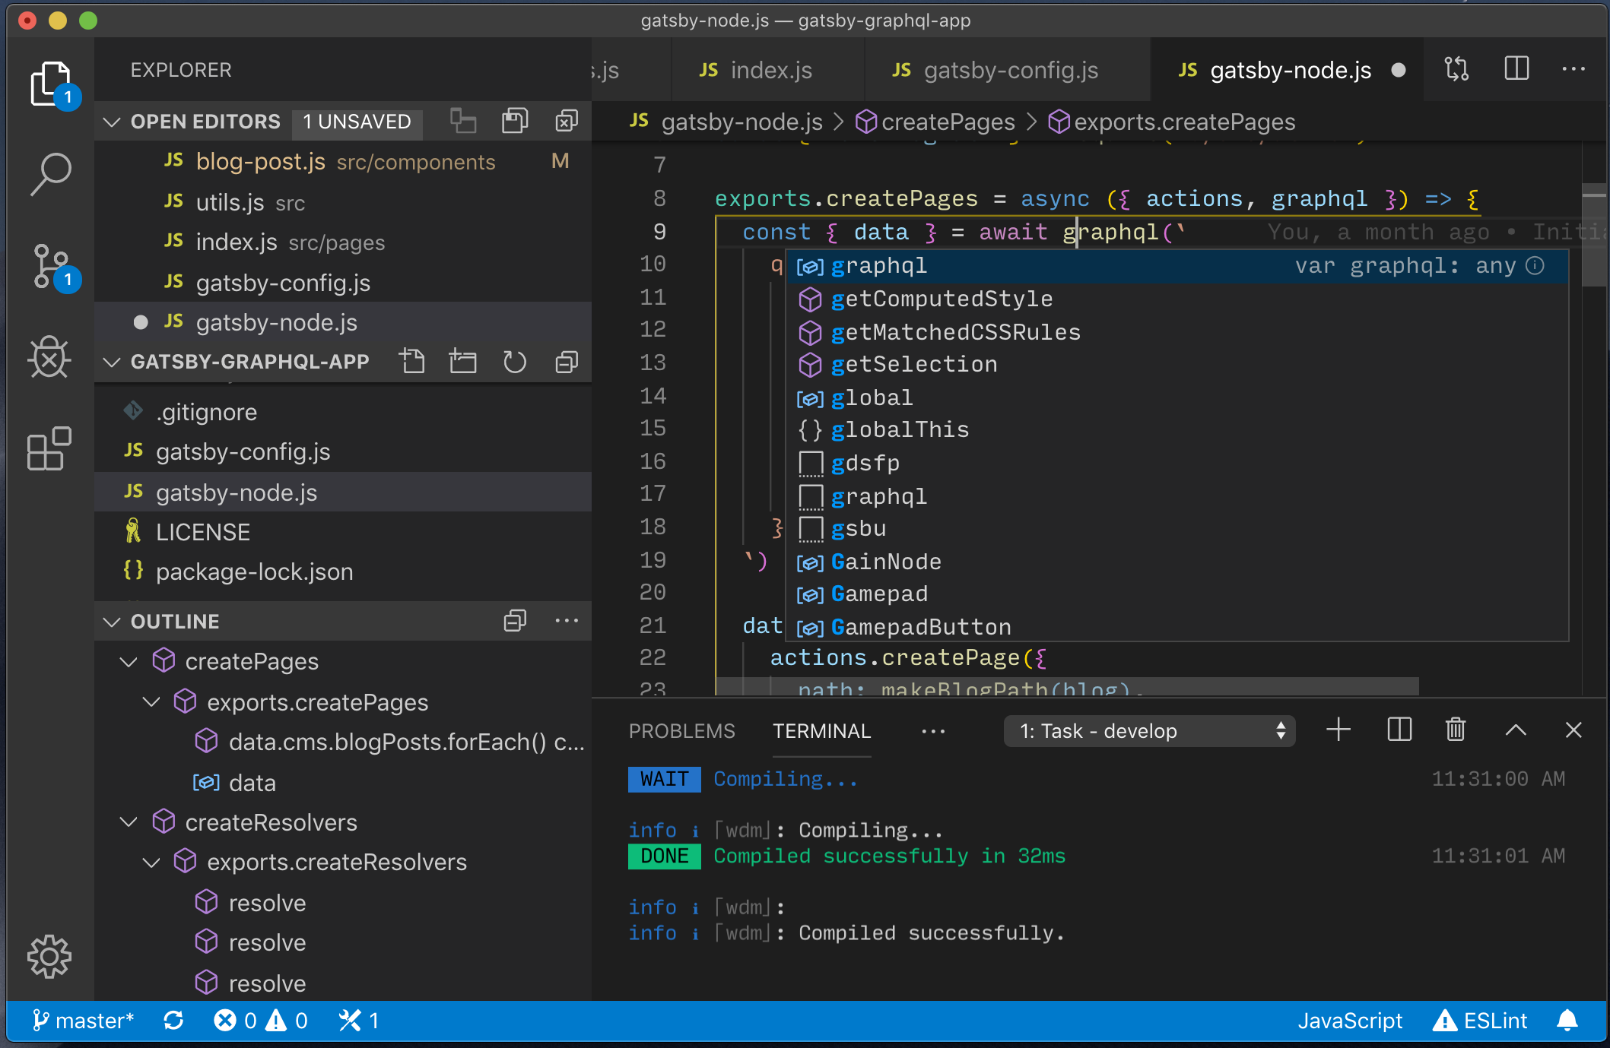
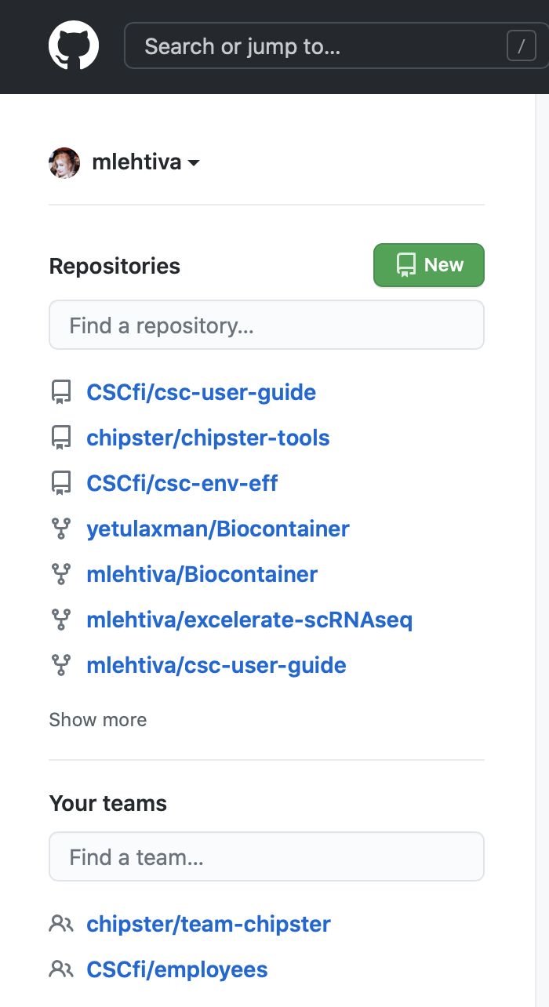
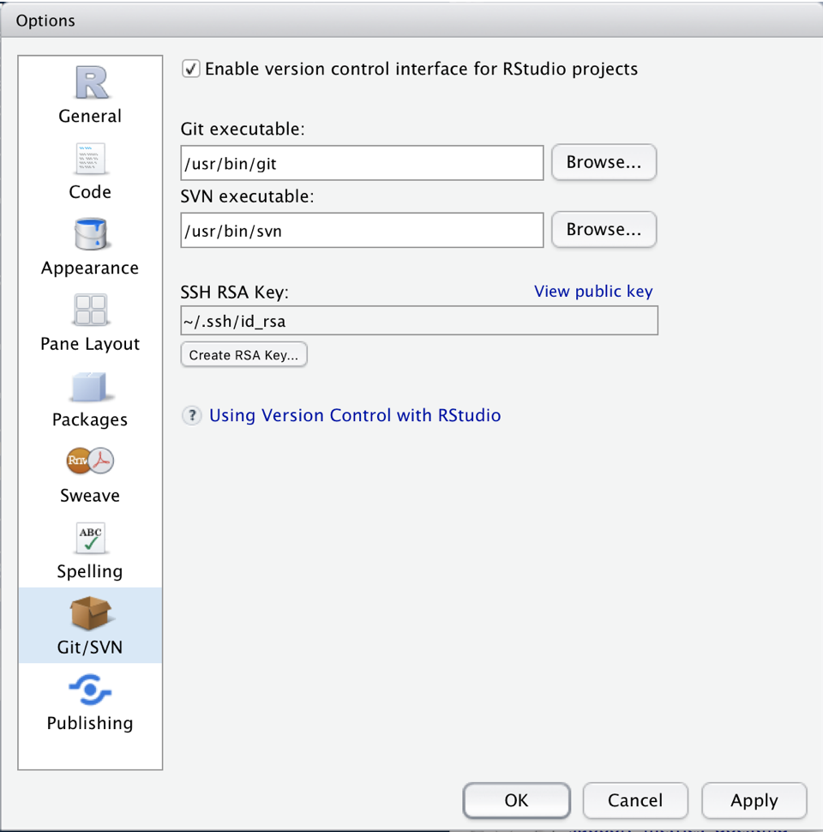
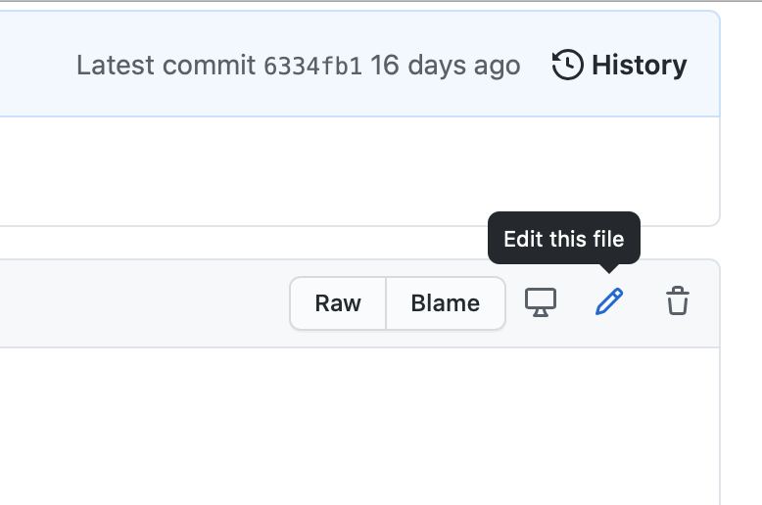
How to use git?
Command line (=terminal)
GitHub, GitLab
Handy graphical GUIs
GitHub Desktop, Visual Studio Code, Sourcetree, Fork…
Directly from RStudio
…
Lot’s of great easy-to-approach material online!
https://coderefinery.org/lessons/
Notes:
https://support.rstudio.com/hc/en-us/articles/200532077-Version-Control-with-Git-and-SVN

Slide 7
Containers -what & why?
Even if you have the code and data in git, the chance of the environment (=combination of softwares and their dependencies) might cause problems
Problem: Solution:
Source: my colleague Laxman Yetukuri

Slide 8
Containers
A container packages up
software code and all its dependencies
Scientific workflow and even data (rather: elsewhere)
…so that application runs quickly and consistently on any infrastructure
“Sandbox”
Sharable
Motto: Build, ship and then run it anywhere
Lightweight version of building a virtual machine
Singularity
(for HPC environment,
can be run without admin rights)
Notes:
Singularity enables users to have full control of their environment. Singularity containers can be used to package entire scientific workflows, software and libraries, and even data. This means that you don’t have to ask your cluster admin to install anything for you - you can put it in a Singularity container and run. Did you already invest in Docker? The Singularity software can import your Docker images without having Docker installed or being a superuser. Need to share your code? Put it in a Singularity container and your collaborator won’t have to go through the pain of installing missing dependencies. Do you need to run a different operating system entirely? You can “swap out” the operating system on your host for a different one within a Singularity container. As the user, you are in control of the extent to which your container interacts with its host. There can be seamless integration, or little to no communication at all. What does your workflow look like?

Slide 9
Containers –use cases
Installation method –when installation otherwise tricky
Many dependencies
Incompatible with the environment
Size and number of files reduced
R & RStudio, some bioapplications/pipelines at CSCs supercomputers
Softwares shared as containers
Trainings – hands-on environment and data
Publications link to git repos containing everything needed to repeat the analysis -incl. the container image (=large file) or a recipe for creating it!
Share
Singularity
Notes:
Singularity enables users to have full control of their environment. Singularity containers can be used to package entire scientific workflows, software and libraries, and even data. This means that you don’t have to ask your cluster admin to install anything for you - you can put it in a Singularity container and run. Did you already invest in Docker? The Singularity software can import your Docker images without having Docker installed or being a superuser. Need to share your code? Put it in a Singularity container and your collaborator won’t have to go through the pain of installing missing dependencies. Do you need to run a different operating system entirely? You can “swap out” the operating system on your host for a different one within a Singularity container. As the user, you are in control of the extent to which your container interacts with its host. There can be seamless integration, or little to no communication at all. What does your workflow look like?

Slide 10
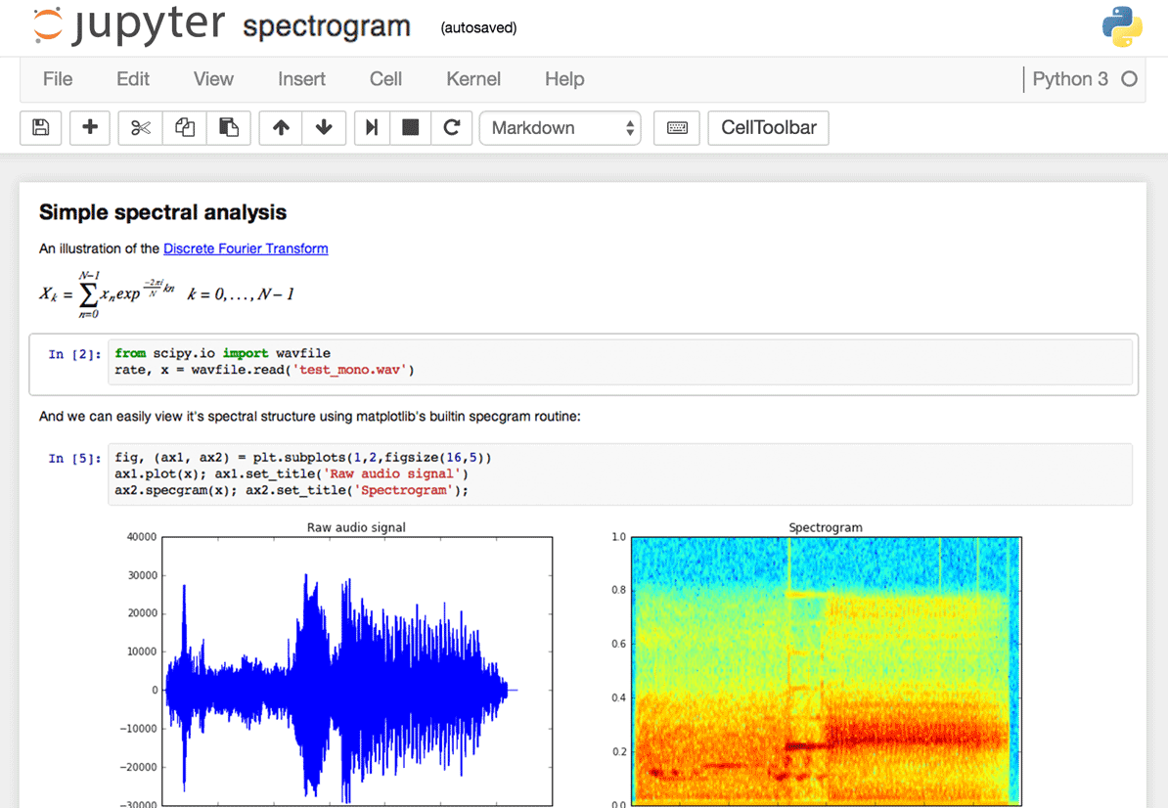
Jupyter notebooks
“an web-based environment in which users execute code, see what happens, modify and repeat in a kind of iterative conversation between researcher and data”
“Jupyter” = Julia+Python+R, but nowadays dozens of programming languages

Slide 11
Jupyter notebooks and (CSC) Notebooks
Use cases:
Experimenting, testing, data analysis, visualisation = digital notebook
Interactive work on HPC clusters
Sharing and explaining, teaching, learning
Supplementary information with published articles
Notebooks.csc.fi – our easy-to-use environments for working with data and programming
Especially handy for trainings
Ready notebooks for basic R and Python, but also for Machine learning, data science, deep learning…
Share &
open
Learn more: https://coderefinery.github.io/jupyter/
Share and open your notebooks: https://mybinder.org

Slide 12
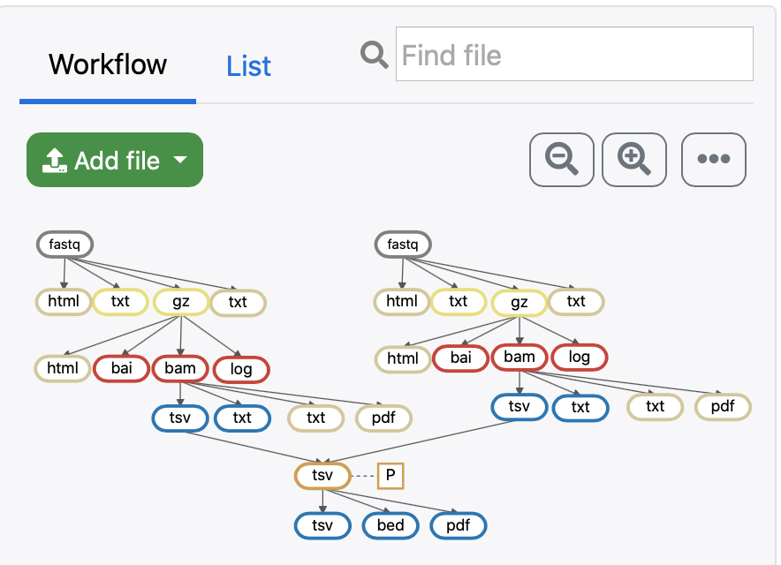
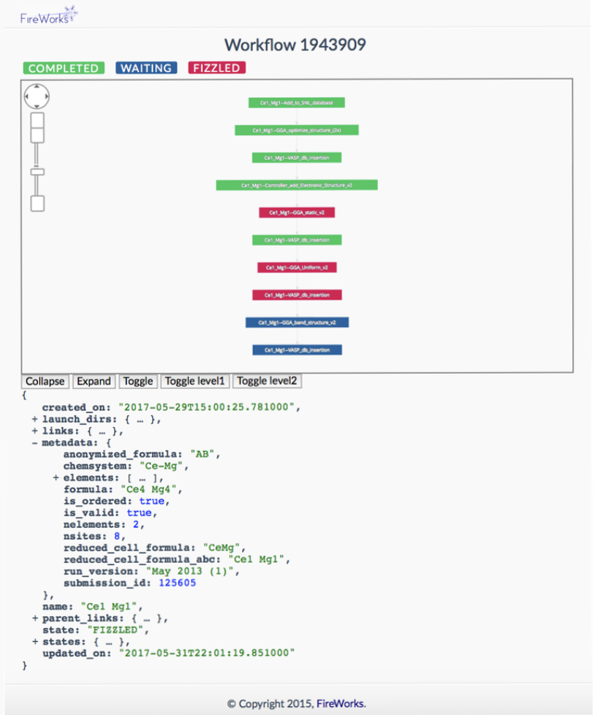
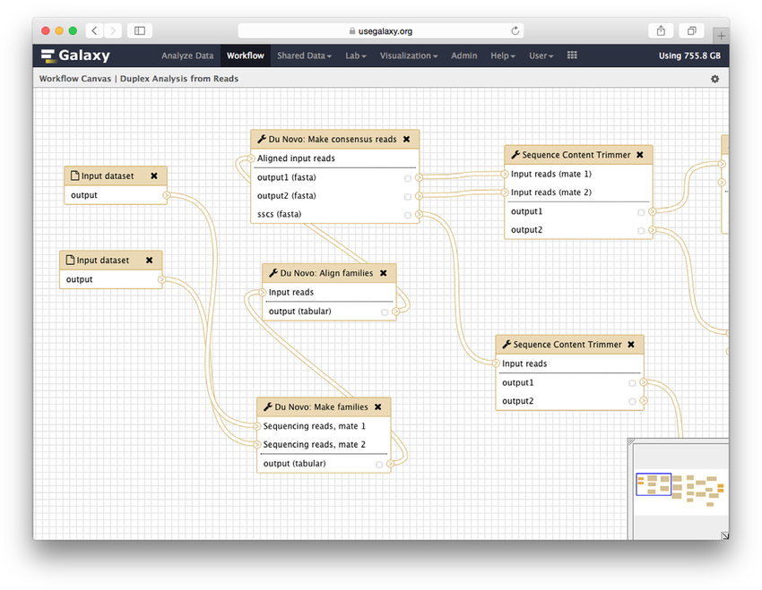
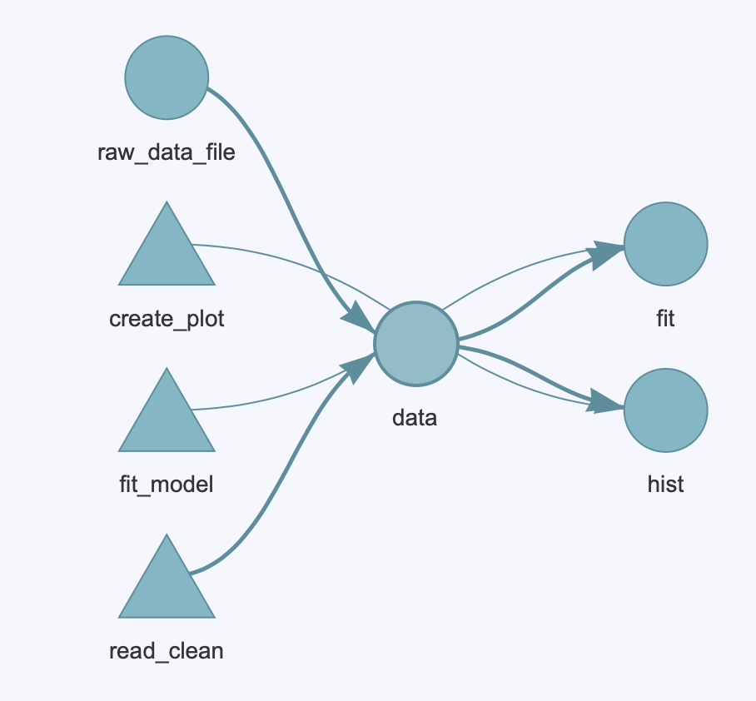
Workflows
Workflow ($≈$pipeline) = a bit general term…
Here: computational data-analysis workflow created so that it is portable and works in different environments
Why?
Easy to repeat (automation)
Easy to modify
Step by step
No need to re-run everything

Slide 13
Summa summarum
Workflow / pipeline
(=analysis steps)
Codes / scripts
Software environment
container recipe
+ Data…

Slide 14
More info –where?
CSC services: servicedesk@csc.fi
NEIC CodeRefinery
Next workshop May 10-12 and 18-20
https://coderefinery.github.io/2021-05-10-workshop/
learning materials: https://coderefinery.org/lessons/
Try for example:
Reproducible research: https://coderefinery.github.io/reproducible-research/
Git: https://coderefinery.github.io/git-intro/
Containers: https://coderefinery.github.io/reproducible-research/07-docker/
Workflows: https://coderefinery.github.io/reproducible-research/04-workflow-management/
notebooks: https://coderefinery.github.io/jupyter/

