Slide 1
CSC´s generic services for storing, sharing and publishing data
18.5.2022, 10:00-11:30

Slide 2





Welcome to CSC´s generic services for storing, sharing and publishing data webinar!
The webinar will be recorded.
Questions & answers will not be recorded
Please keep your microphone muted.
Please use chat for questions at any time.
During Q&A sessions you can also raise your hand for asking questions.

Slide 3
CSC´s generic services for storing, sharing and publishing data
Allas (Tua Hindersson-Söderholm)
Fairdata (Erja Kortelainen, Suvi Pousi)
EUDAT (Anssi Kainulainen)
  Short introductions and key benefits of each service
  Comparing the services
  UI examples and development plans

Slide 4
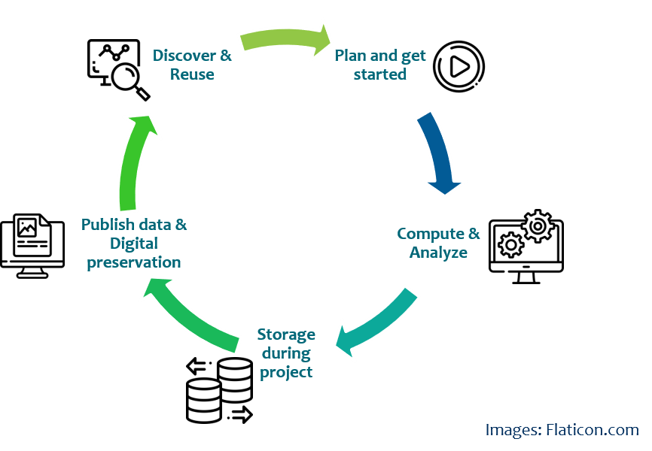
What do we mean by storing, sharing and publishing data?
Storing: storing data in a service for a period of time
Sharing: sharing data through shared storage space or by using links
Publishing data as dataset: Dataset metadata is available for others via a landing page, that has a persistent identifier
Digital preservation: reliable preservation of digital information for several decades or even centuries
Simplified (data) life cycle
Notes:
Dataset: structure and stable collection of data generally associated with a unique body of work, including sufficient metadata. Publishing data as dataset: dataset metadata is available for others via a landing page that has a PID.

Slide 5
Generally about the services´usage policies, the roles and responsibilities
CSC does not assert ownership or any intellectual property rights to data in our services.
It's recommended to agree upon the rights to research data within the research group and research organisation early on
It is the data owner's responsibility to decide which service is suitable for the data in question and that the encryption - if needed - is done appropriately.
The data owner decides on the openness and usage policies for their data.

Slide 6





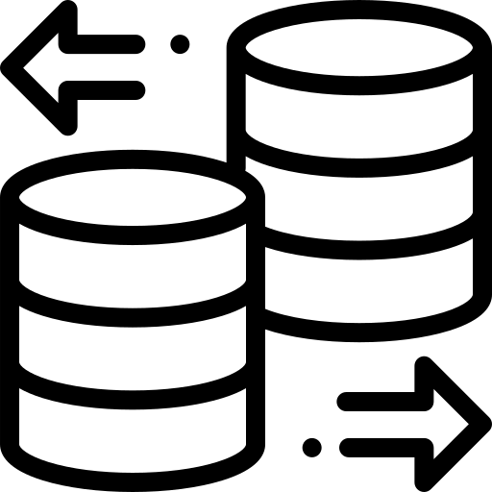

Allas
Purpose of the service:
Storing and sharing - especially large amounts of data - during active phase of the research project.
Key benefits:
Data processing can be done using standard APIs from anywhere.
Data can easily be moved to and from CSC's cloud and computing environments.
More information:
https://research.csc.fi/en/-/allas
Plan and get started
Compute & Analyze
Publish data & Digital preservation
Discover & Reuse
Storage during project
Images: Flaticon.com

Slide 7





Plan and get started
Compute & Analyze
Publish data & Digital preservation
Discover & Reuse
Storage during project
Purpose of the service: Storing, describing, publishing, discovering and preserving research data.
Key benefits:
  Publishing even large or growing research datasets according to FAIR principles free of charge, with easy to use web tools.
  Dataset can be transferred to Digital Preservation Service for Research Data.
  Increased national visibility for published data through research.fi portal.
More information: https://www.fairdata.fi
Images: Flaticon.com
Fairdata.fi

Slide 8

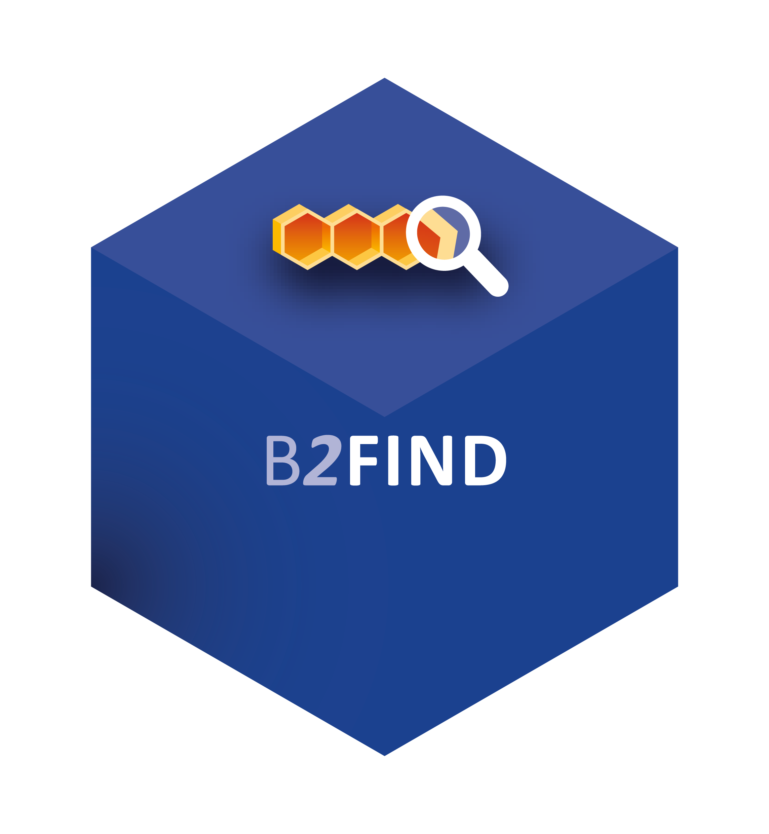
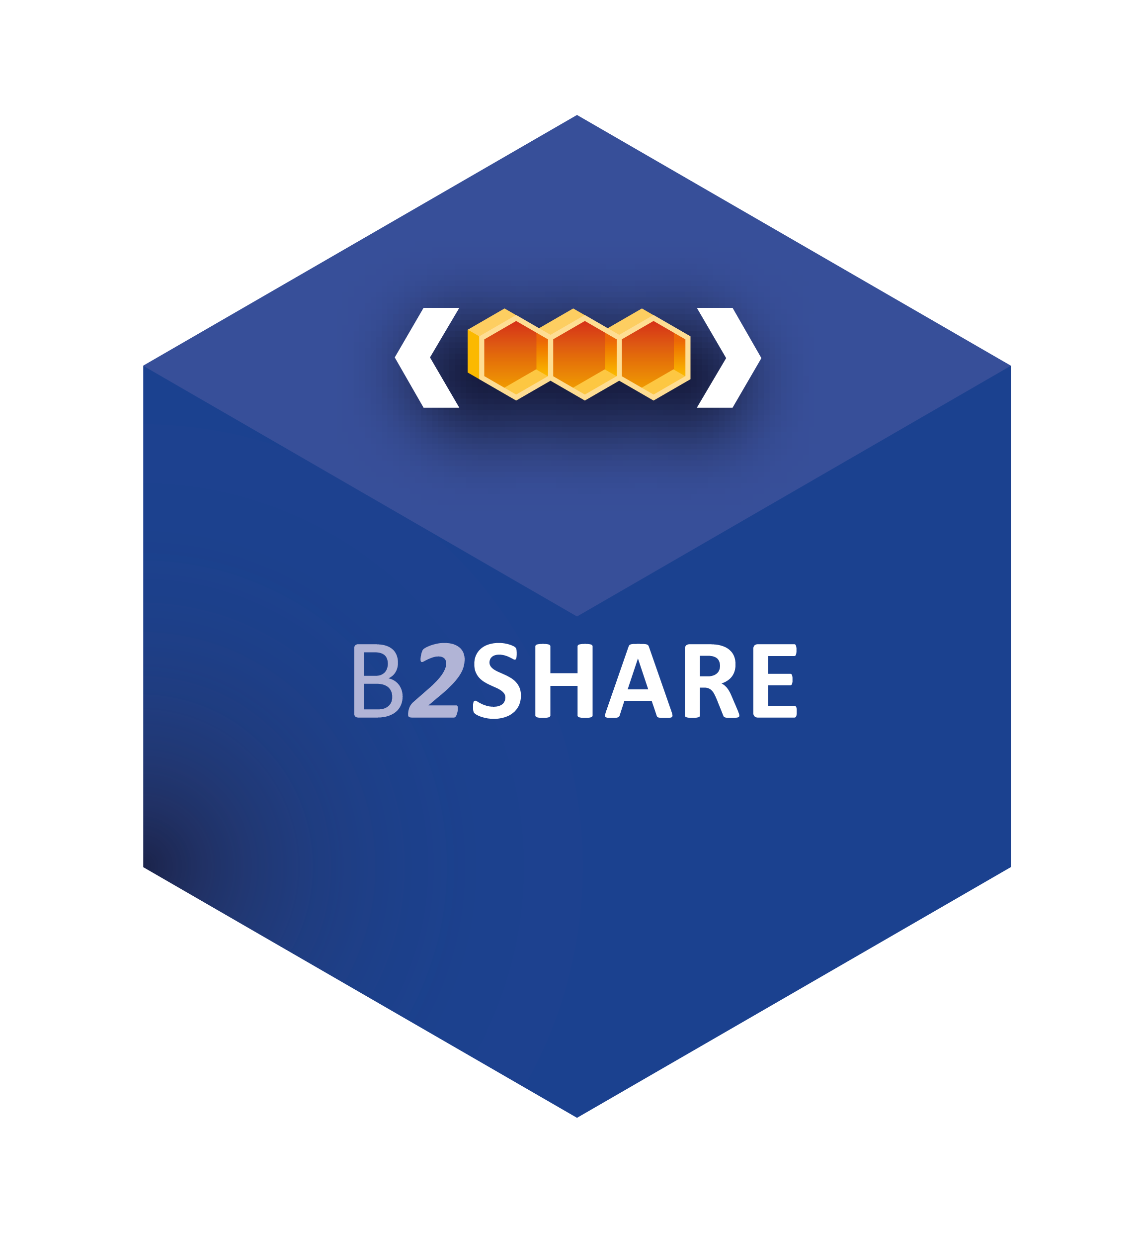
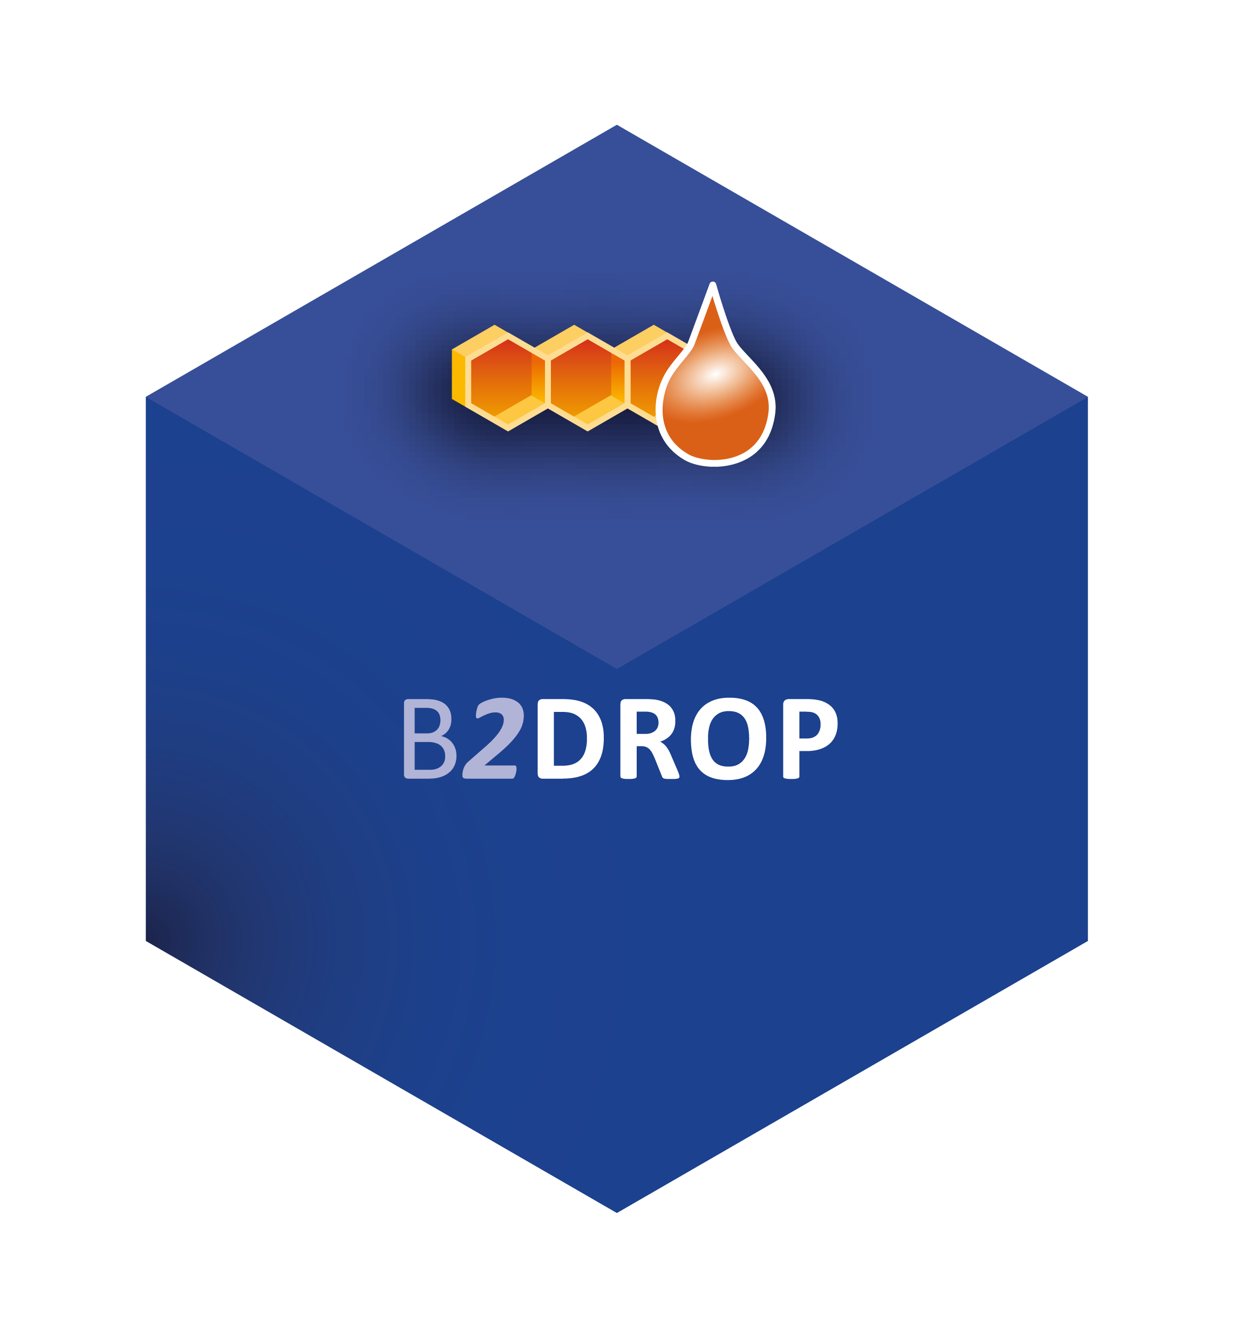

Purpose of the service: Same as Fairdata, with the difference that EUDAT
  provides an easy access to international
  infrastructures, services and resources
  does not offer Digital Preservation
Key benefits:
  Can be tailored to meet the specific needs of a
  community in terms of metadata, storage space,
  user management and branding.
  Shared core schema and dataset findability through B2FIND. Support for access across multiple international organizations.
  Supports policy driven data management through automation and open APIs
Plan and get started
Compute & Analyze
Publish data & Digital preservation
Discover & Reuse
Storage during project
Images: Flaticon.com
Eudat.eu
Notes:
Tailored to meet the specific needs of a community in terms of metadata, storage space, user management and branding.
Storing, replicating and implementing data management policies across multiple EUDAT service provider repositories. Shared core schema and dataset findability through B2FIND. Support for access across multiple international organizations.

Slide 9
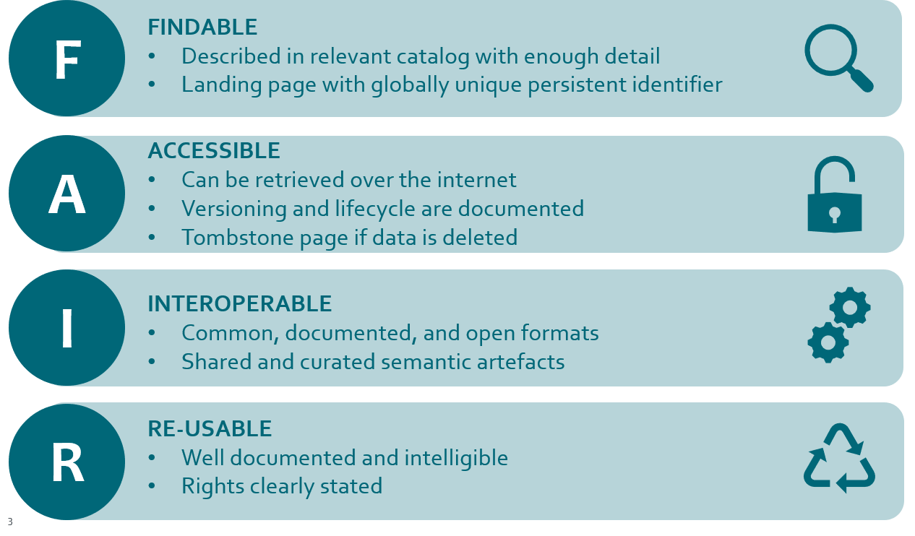
How Fairdata and EUDAT services can help to comply with FAIR principles, which Allas does not
Services utilize many common vocabularies (F, I)
Stored data can be made part of datasets, described and published (A, R)
Published dataset has a persistent identifier and landing page, through which data can be accessed (F, A, I, R)
Research data documentation is available in an interoperable, machine-readable format
(F, A, I, R)

Slide 10
Service Comparison Table 1/2
 | Allas | Fairdata | EUDAT
Where is the data stored? | In Finland | In Finland | In Finland (replicas in EU, if customer wishes)
Chargeability | Free of charge for Finnish research | Free of charge for Finnish research | Public services free for everyone Premium services based on contract with organization
Tailoring possibilities | No | No | Yes, per contract or possible EU-project collaboration
Suitable for sensitive data | Yes (encrypted) | No (in Digital Preservation Service discussions ongoing) | No
Data integrity | Erasure Coding, Checksums | RAID, Checksums, File replicas In Digital Preservation Service: part of service promise with e.g. active error correction | RAID, Checksums and/or File replicas in some services per contract

Slide 11
Service Comparison Table 2/2
 | Allas | Fairdata | EUDAT
Storage period | Active phase of research project | Active phase of research project After the project according to home organization policy (In Digital Preservation Service: decades or even centuries) | Public services: data is stored continuously. Premium services: policy definable by customer.
Available storage quotas | 10-200 TiB | 1 Gib to several TiBs In Digital Preservation Service: according to Ministry's decisions | Public services: 20 GiB per dataset/file/user Premium services: policy definable by customer.
Sharing data | Yes | Yes, also dataset metadata can be co-edited | Yes
Publishing datasets with persistent identifiers (PIDs) | No | Yes | Yes
Curation by service provider | No | In Digital Preservation Service (keeping data readable and usable, e.g. conversion of obsolete file formats) | No * bit level (B2SHARE, B2SAFE)

Slide 12
Questions?

Slide 13
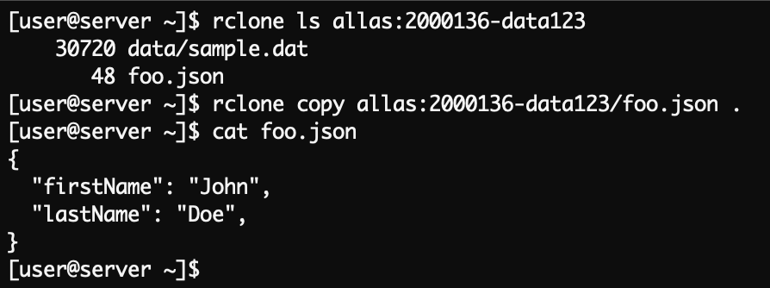
Allas – command line interface
Puhti and Mahti servers at CSC support many different tools for using Allas, these include:
Allas-specific a-commands (pack and move data automatically)
Rclone is good for cases when the data will be used outside CSC too
swift python client that provides wide range of functionalities
s3cmd an S3 client and persistent Allas connections
These can can be used in other Linux servers as well after installation and configuration, e.g. a virtual machine running in cPouta or a Linux-based laptop.
Note that the data cannot be modified while it is in Allas. It must be downloaded to a server for processing, and the previous version replaced with a new one.

Slide 14
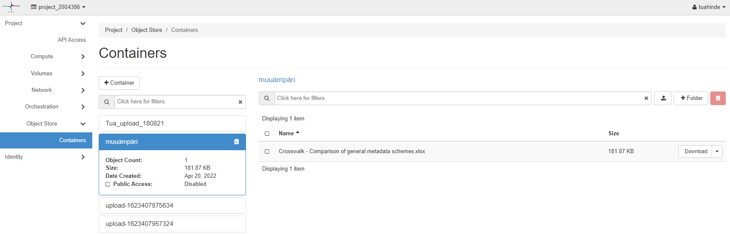
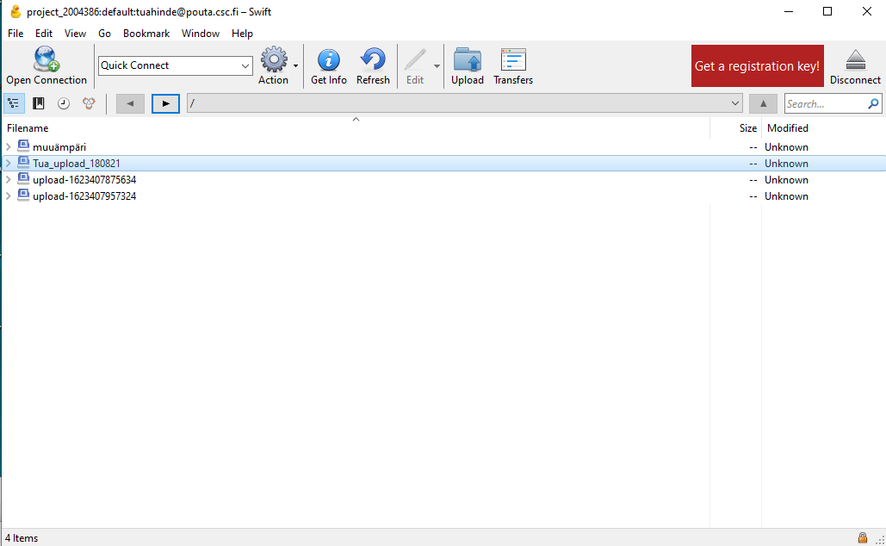
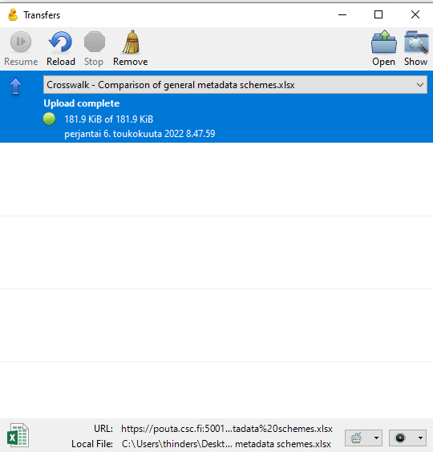
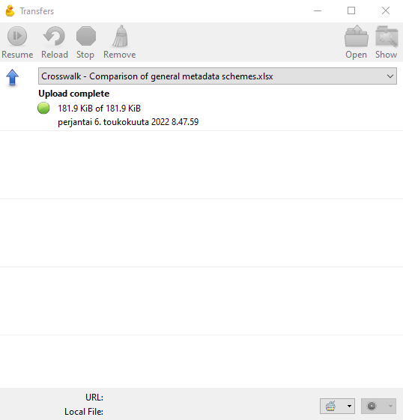
Allas – graphical user interfaces
OpenStack Horizon Dashboard (pouta.csc.fi):
Locally installed client software, example from Cyberduck:
SD Connect provides a sensitive data oriented web interface for Allas, which encrypts the uploaded data by default so that it can be used in SD Desktop service.

Slide 15
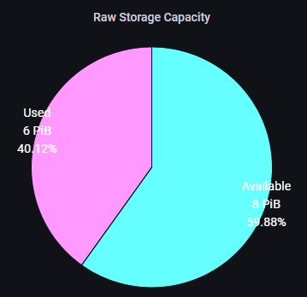
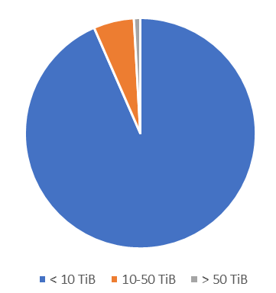
Allas usage
Rate of utilization (17.5.2021):
Amount of CSC projects 2021 with data in Allas:
Amount of data stored in Allas per CSC project 2021:
Sector​ | CSC projects
HEI​ | 604​
Research institutes​ | 85​
Public sector​ | 1​
In total​ | 690​
< 10 TiB: 93%, 10-50 TiB 6%, > 50 TiB: 1%

Slide 16
Interesting things going on in Allas Service
Easier Allas quota management with MyCSC
Data deletion process
  More information: Introducing CSC's content retention policy in Services for Research and Education
Graphical user interface with possibility to copy data to IDA

Slide 17
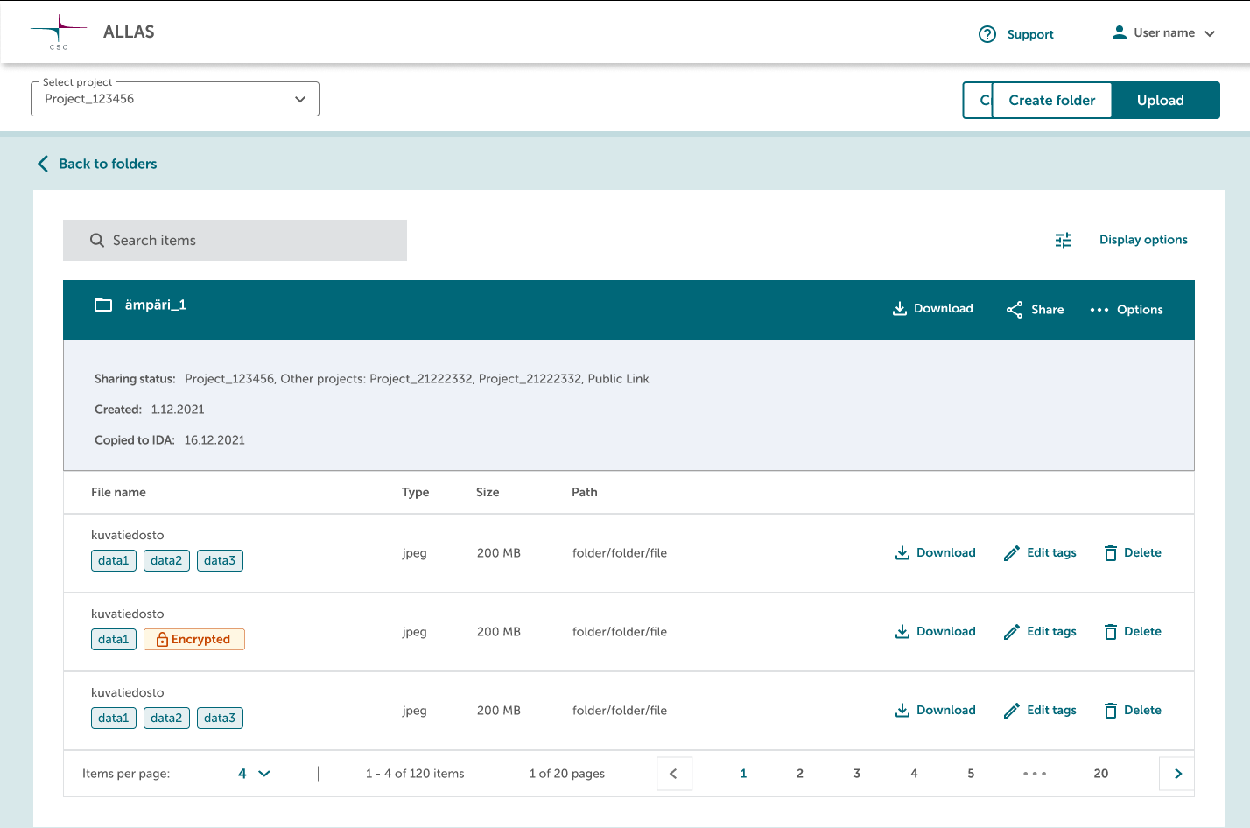
Allas – design picture for the planned graphical user interface

Slide 18
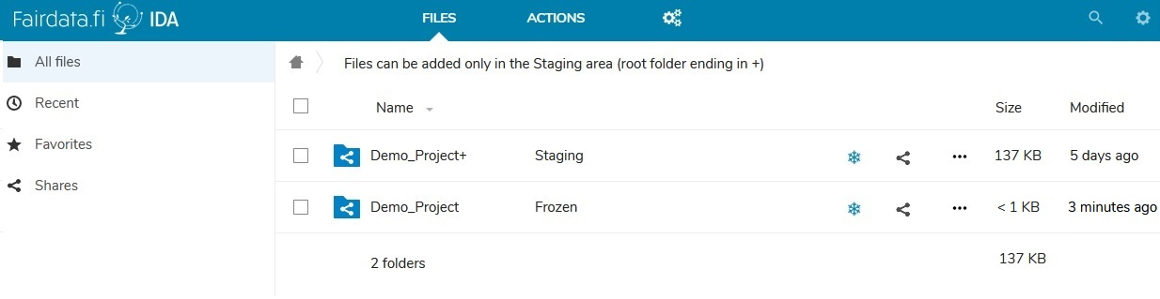
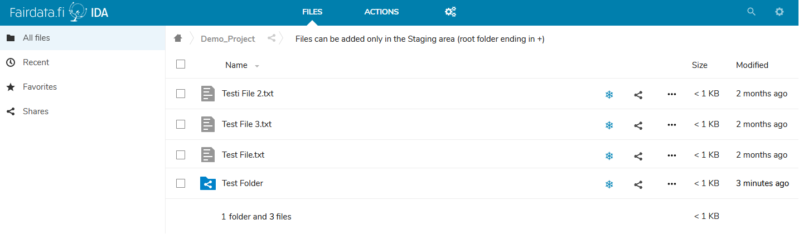
Fairdata IDA – Research Data Storage
ida.fairdata.fi
Easy-to-use graphical user interface to
  Upload files
  Reorganize and rename the files
  Freeze in immutable state
Command line tools available for uploading large amounts of data

Slide 19
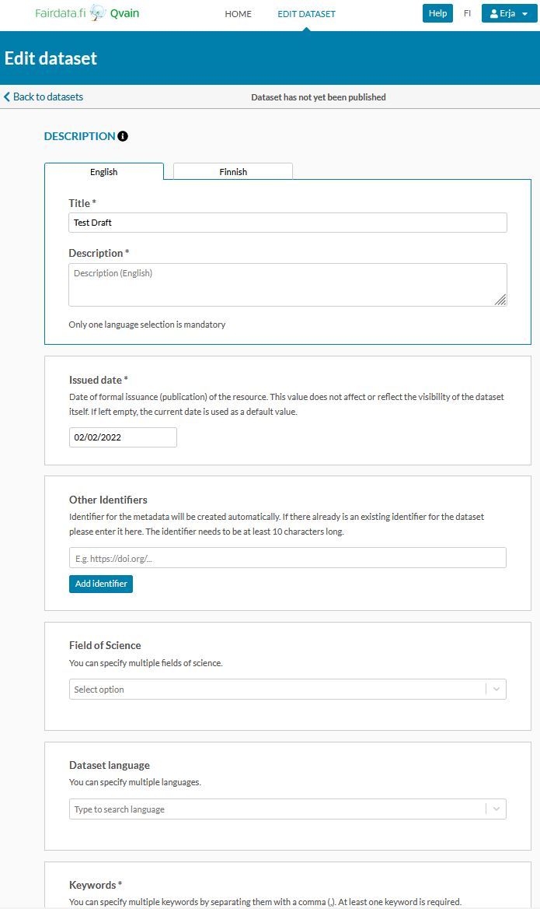
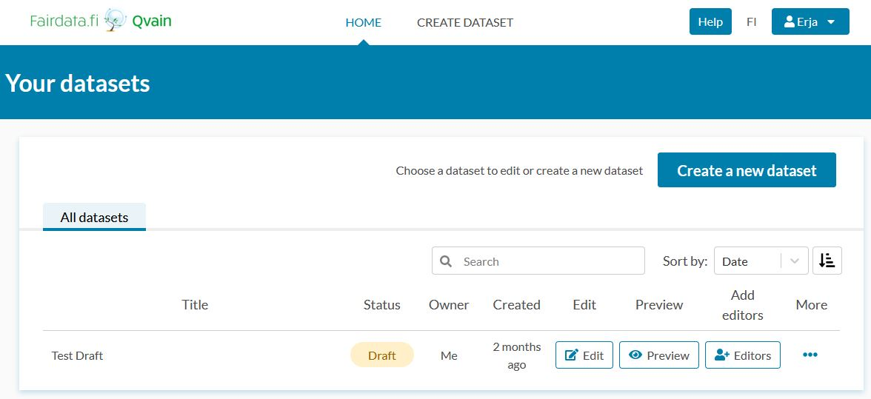
Fairdata Qvain – Research Dataset Description Tool
qvain.fairdata.fi
Set of fields to fill-in to describe the data as a research dataset
  Link your data either from Fairdata IDA or outside of Fairdata
Publish to make visible in Fairdata Etsin

Slide 20
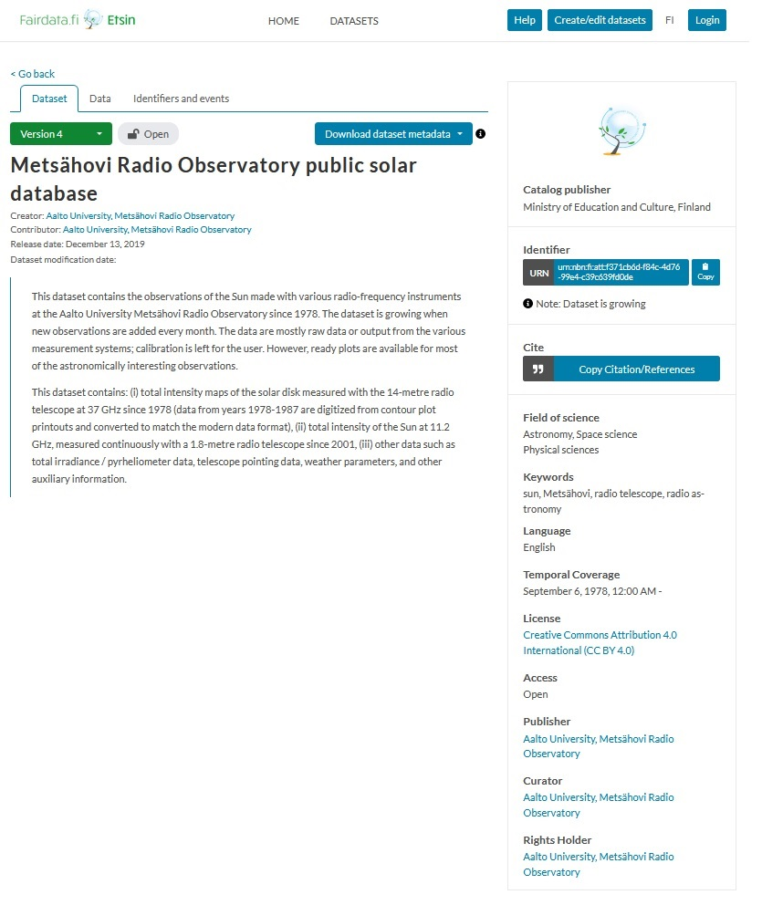
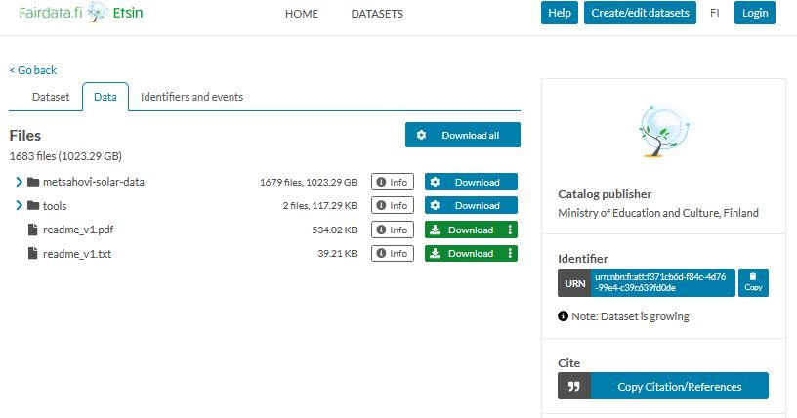
Fairdata Etsin – Research dataset Finder
etsin.fairdata.fi
Search and find published datasets
Download data

Slide 21
Fairdata Usage
Amount of CSC projects 2021 with data in IDA:
End of 2021:
  Over 1 PB of data stored in IDA
  Over 10 000 published datasets in Etsin
  8 Finnish higher education institutions and state research institutes utilizing Digital Preservation Service for Research Data (preservation agreements)
Sector​ | CSC projects
Higher education institutions | 389
Research institutes​ | 24
In total​ | 413

Slide 22
Interesting things going on in Fairdata Services
Easier UI for describing datasets
More datasets findable through new integrations to organization's own repositories
Organization main user accounts to support organization's users' metadata creation and data lifecycle
Data access by permission applications
Digital Preservation Service:
  Investigating and planning the possibility to preserve also Sensitive Data
  Project for specifying the organizations' DPS processes in more detail

Slide 23
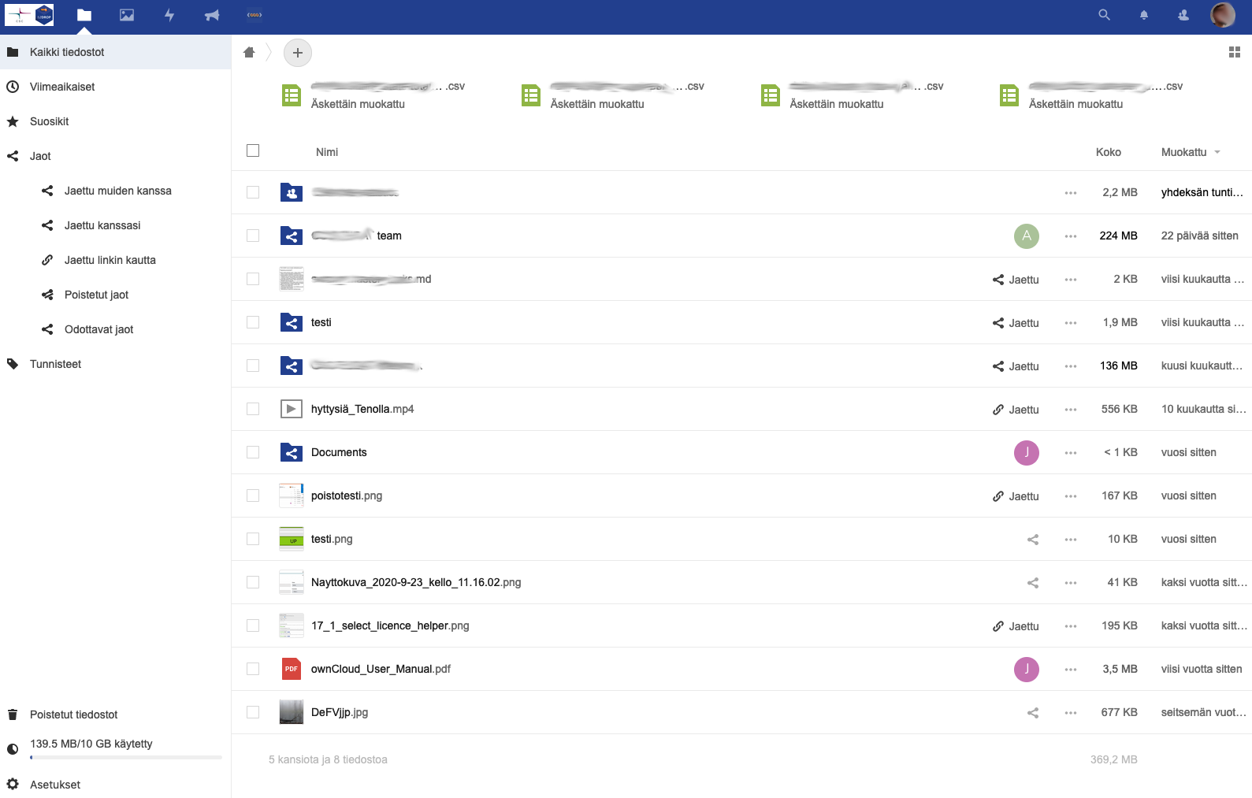
EUDAT B2DROP
Store, share and synchronize data
Access via WebGUI, desktop client & Webdav
File versions
Tailoring, e.g. user & access management, additional storage space etc.

Slide 24
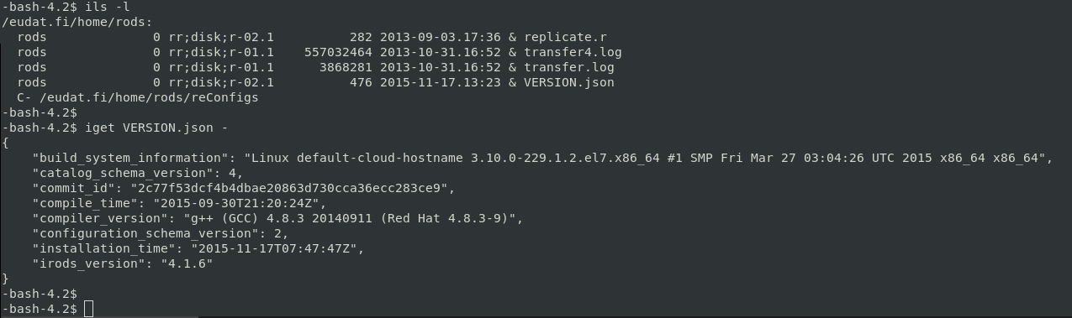
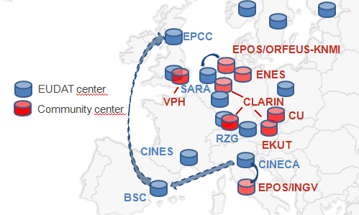
EUDAT B2SAFE
Policy-based data management: PID registration, cross-site replication, data integrity checks etc.
Supports large scale storage, active data and archival
Interaction options: iRODS i-commands, GridFTP, http-api

Slide 25
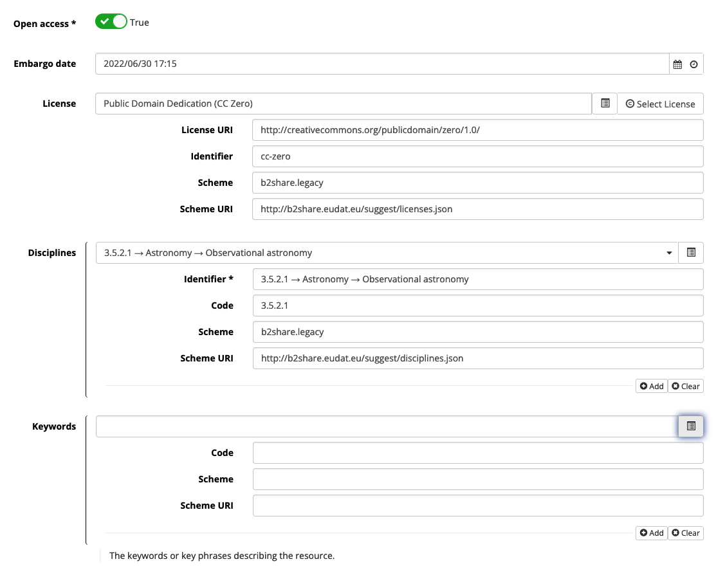
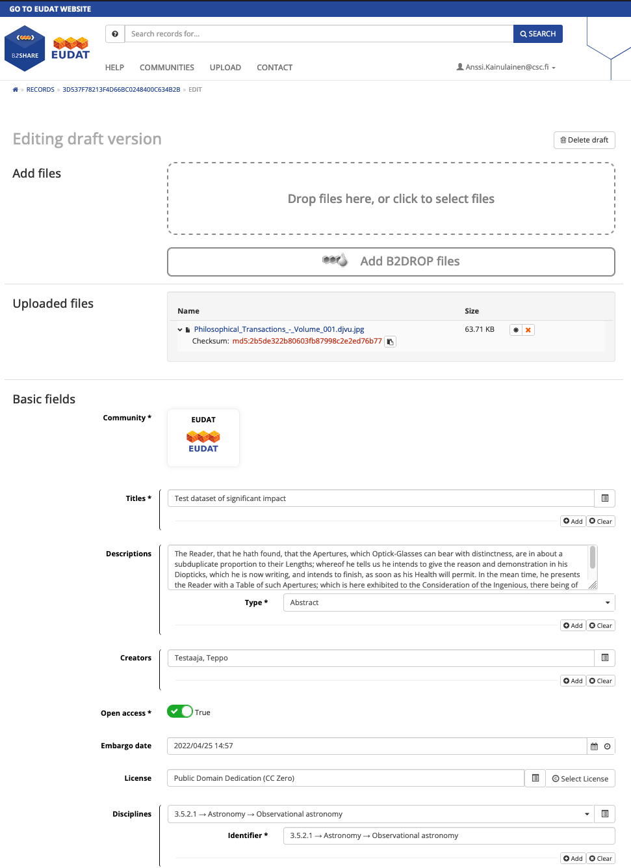
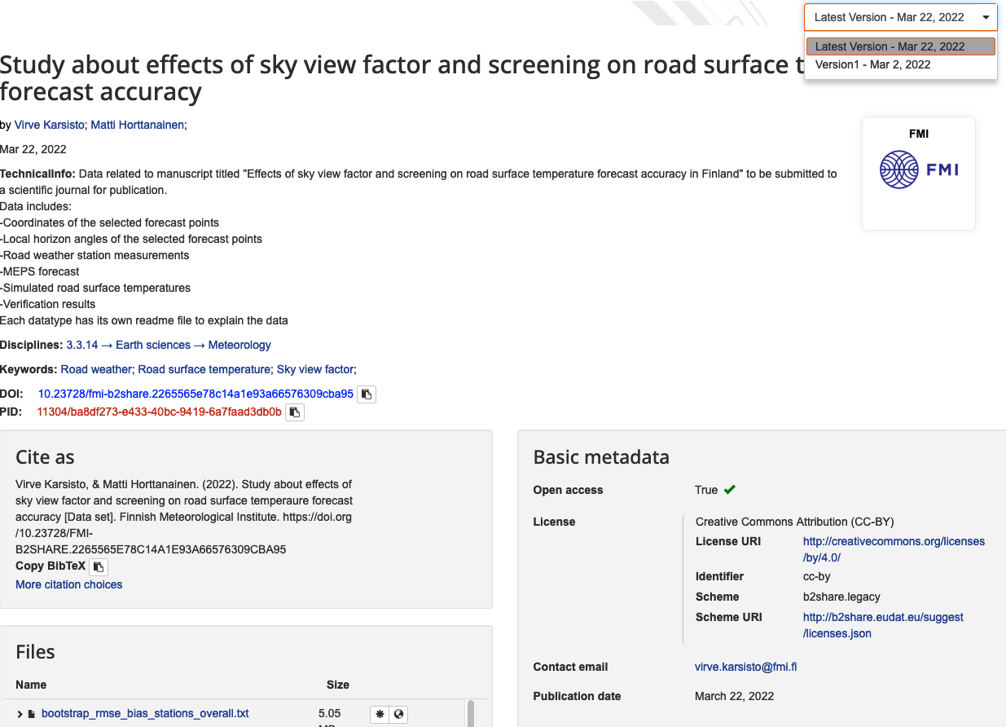
EUDAT B2SHARE
Describe and publish datasets
Store or link to data, direct upload from B2DROP
Shared EUDAT core schema + schema extensions support specific community needs
WebGUI and API for workflow integration

Slide 26
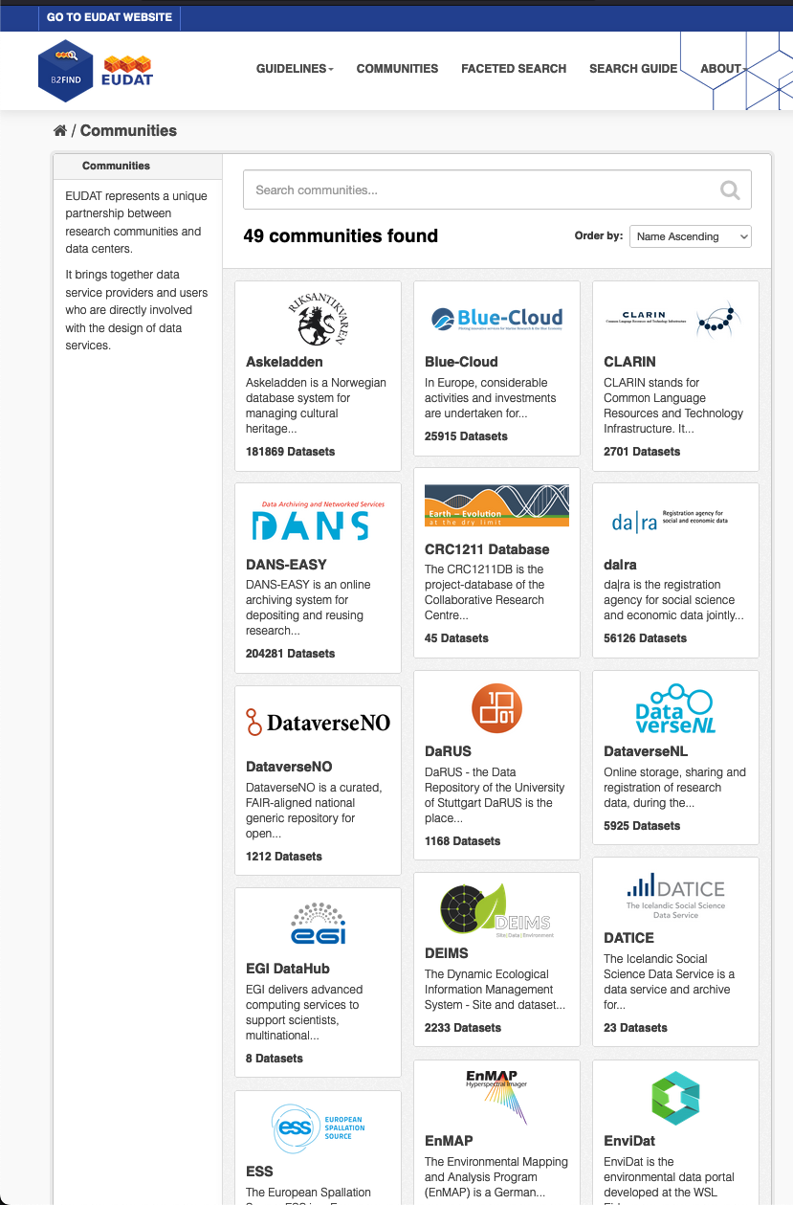
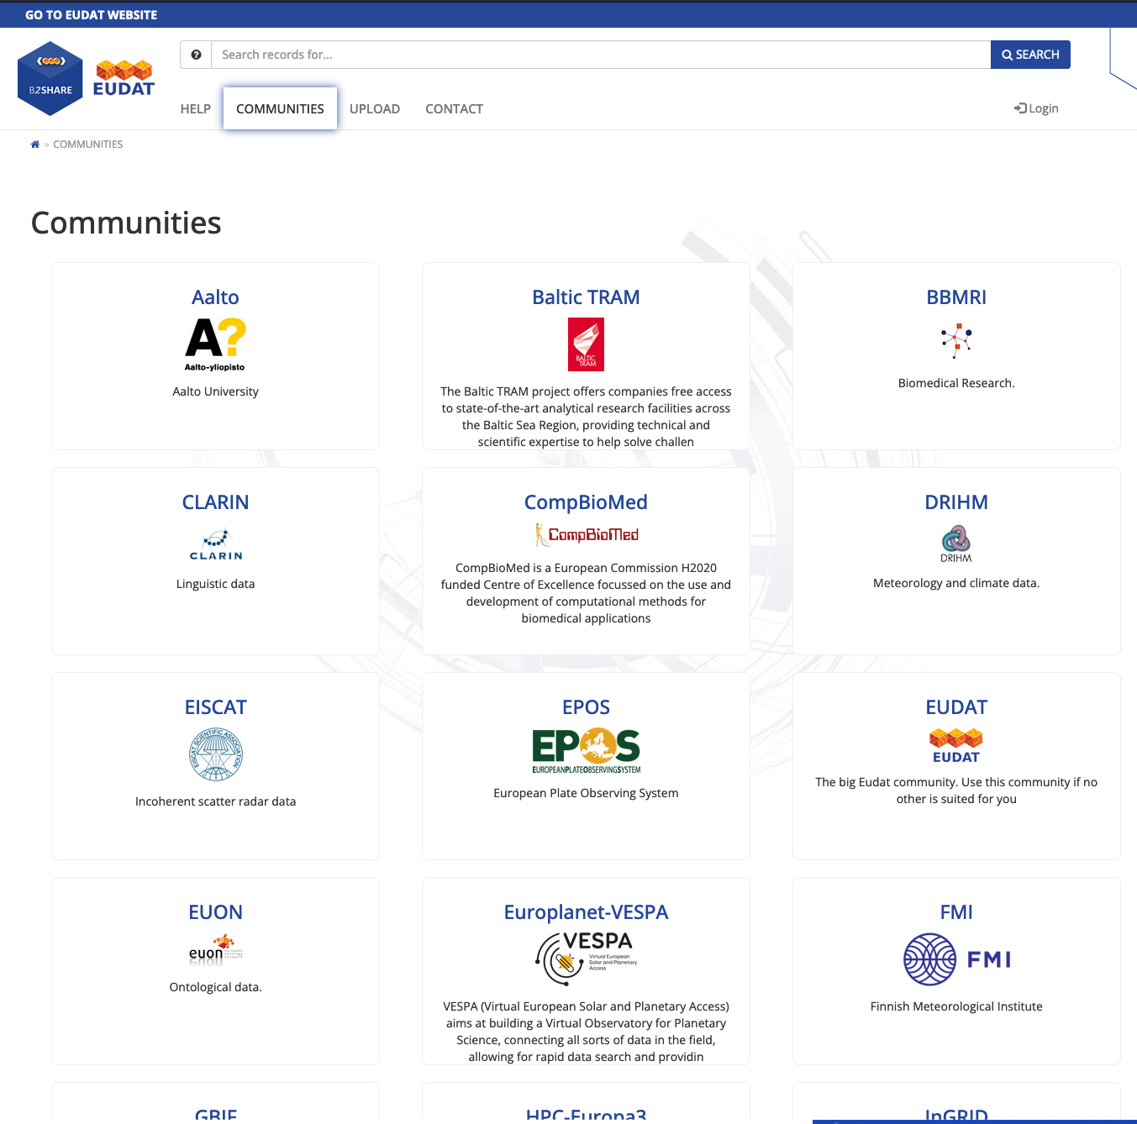
EUDAT B2SHARE & B2FIND
Harvesting repositories via different protocols: OAI-PMH, CSW, REST-APIs
Aggregating different community repositories
Harmonizing descriptions via EUDAT Core Schema

Slide 27
EUDAT usage
EUDAT CDI total used storage capacity (April 2022): 1571 TB
  in all instances of all service types (B2DROP, B2SAFE, B2SHARE)
EUDAT CDI total registered objects (April 2022): 65,8 million objects
  Files, datasets etc.
EUDAT CDI total communities (April 2022)
  32 B2SHARE communities (public and dedicated service instances)
  49 B2FIND communities (harvested from B2SHARE instances and other repositories)

Slide 28
Interesting things going on in EUDAT Services
New customer and community deployments
Tailored features for selected customers
EUDAT schema version updates for selected communities
Datasets of selected B2SHARE communities made findable in B2FIND and Fairdata
Virtu identification option for selected instances
Major version updates for B2SHARE, B2SAFE, B2DROP (effects on functionality and features may vary)

Slide 29
Questions?

Slide 30
Webinar on Digital Preservation Service (Fairdata-PAS)
For Data Support Personnel at research organizations
23rd of May at 12:00-15:00
https://ssl.eventilla.com/event/Q2zRM

Slide 31
Thank you!

